Slide 1
Antibiotic Stewardship in the Neonatal Intensive Care Unit: A Quality Improvement Project
Emma Borgmann, DNP-NNP, APRN-BC, RNC-NIC, C-ELBW

Slide 2
Learning Objectives
Identify potential complications of antibiotic administration in premature infants
1
Describe the importance of antibiotic stewardship programs
2
Identify what neonates are low risk for sepsis and when to not administer antibiotics
3

Slide 3
Financial Disclosures
No financial disclosures

Slide 4
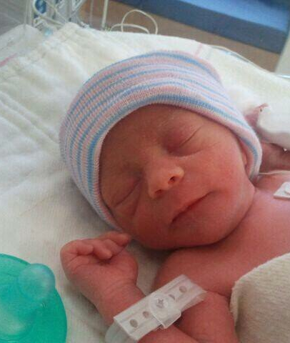
Introduction
Antibiotic stewardship is "the effort to measure & improve how antibiotics are prescribed by clinicians and used by patients". ¹​
324,000 to 468,000 NICU admissions annually²​
Complications include necrotizing enterocolitis (NEC), increased risk of invasive fungal infection, increased drug resistance, late onset sepsis, or death³

Slide 5

Significance
Up to 50% of antibiotics prescribed are unnecessary in the NICU^{2​}
The Infectious Disease Society of America and the Society for Healthcare Epidemiology of America recommend antibiotic stewardship programs in acute care hospitals​
Antibiotic days of treatment decreased with utilization antibiotic stewardship programs⁴

Slide 6
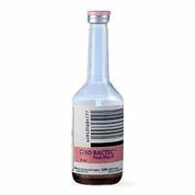
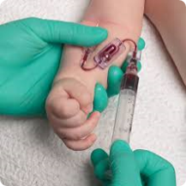
Local Problem
2023 - 2,681 preterm births in NE⁵
Nearly all neonates born 30-33 6/7 weeks gestation at the facility received antibiotics on admission regardless of sepsis risk factors ​

Slide 7
Clinical Problem
Neonates in the NICU born at 30 to 33 6/7 weeks gestation are receiving antibiotics unnecessarily ​
Evidence shows significant fluctuation in the duration and selection of antibiotics ​
At increased risk for morbidity associated with antibiotic resistance, late onset sepsis, fungal infections, and even death

Slide 8

Review of the Literature
Antibiotic Administration Rates​
Up to 87% of VLBW & ELBW infants receive antibiotics in 1st three days of life⁶​
Prolonged antibiotic use was seen in up to 38%^{7​}
Standardization of Antibiotic Administration​
The American Academy of Pediatrics guidelines ⁷

Slide 9
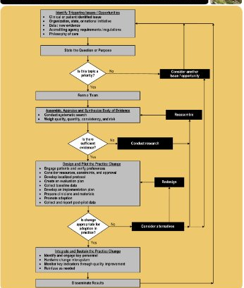
The Iowa Model Revised 8

Slide 10
Purpose
Decrease antibiotic administration in neonates born 30-33 6/7 weeks gestation in the NICU

Slide 11
Aims
Developed an antibiotic stewardship algorithm based on AAP recommendations ​
Provided education to NICU providers prior to implementation ​
Monitored blood culture results and sepsis rates

Slide 12

Setting
Location: Level III 25-bed Lincoln, Nebraska NICU ​
Admission of approximately 500 neonates a year

Slide 13
Participants
30-33 6/7 week gestational age neonates with mild respiratory distress (noninvasive support & ≤ 30% fio2)​
To exclude: those transferred to another facility or those who died within the first 72 hours of life

Slide 14

Ethical Considerations
Neonates are a vulnerable population​
No patient identifiers were collected​
No additional laboratory testing or procedures were done above current standard of practice​
Creighton IRB was consulted for project approval​
​

Slide 15
Methods
Education to NICU providers​
Hard copy of algorithm was available for providers and was posted at workstations​
Weekly assessment of algorithm compliance
Re-education & continued evaluation of algorithm

Slide 16

Team Roles
Multidisciplinary team included:​
Neonatal Nurse Practitioners​
Neonatologists​
Pharmacists​
​

Slide 17
Neonates born 30-33 6/7 weeks gestational age with mild respiratory distress
Mild Respiratory distress:
≤ 30% FiO2
Non-invasive respiratory support
*Evaluate at 2 hours of life*
Low risk EOS:
-Preterm birth due to maternal factors: preeclampsia, noninfectious maternal illness, or placental insufficiency
-Cesarean or vaginal delivery
-Absence of preterm labor
-Induction of labor for maternal factors
-No prolonged ROM
Initial approach:
-No antibiotics
-Blood culture and clinical monitoring
-CBC/CRP after 8 hours of life

Slide 18
Neonates born 30-33 6/7 weeks gestational age with mild to severe respiratory distress
High risk EOS:
-Preterm birth due to cervical incompetence, preterm labor, PROM, chorioamnionitis, intra-amniotic infection, or unexplained onset of non-reassuring fetal status
Approach:
-Blood culture
-Start empirical antibiotics
-CBC/CRP after 8 hours of life

Slide 19
Instrumentation and Data Collection
Chart review performed to collect data over a 5 month period prior to implementation of project and on all infants born 12 weeks after implementation of the antibiotic stewardship template
Data collected: gestational age at birth, birth weight, reason for delivery, antibiotic administration and duration, blood culture results, respiratory support, and FiO2 at 2 hours of life
Utilized descriptive statistics to compare pre and post implementation rates

Slide 20
Demographics
Pre-Implementation (N=26)​
Average gestational age: 31 6/7​
Three on invasive respiratory support​
Average FiO2: 25% (lowest RA – highest 65%)​
Post-Implementation (N=17)​
Average gestational age: 32 4/7 weeks​
All on non-invasive respiratory support​
Average FiO2: 23% (lowest RA – highest 30%)

Slide 22
Post-Implementation Results

Slide 23
Results

Slide 24

Discussion
Antibiotic usage decreased from 100% to 59%​
No poor outcomes for infants​
Four infants that met criteria but received antibiotics​
Provider discretion
​

Slide 25
Strengths, Limitations, & Sustainability
Strengths:​
N size of 17 over the 12-week implementation period​
No poor outcomes for the infants​
Limitations:​
Adjustment period​
Practice change for physicians and nurse practitioners​
Sustainability:​
Feasible to continue algorithm in 30-33 6/7-week gestational age infants​
Potential for expansion to other gestational ages

Slide 26
DNP Implications
Leadership:
Collaboration amongst interdisciplinary teams
Dissemination of project results
Scholarship:
Contributes to evidence-based practice
Translated evidence-based research into practice
Policy:
Can change policy and practice protocols
Clinical:
Protects patients from unnecessary antibiotic exposure
Class:
NUR 899 was beneficial to the development of this project

Slide 27
Acknowledgments
Project Chair​
Dr. Jocquelin Jones DNP, PNP, NNP-BC​
​
Project Champion​
Vanessa Saxton DNP, NNP-BC

Slide 28
References
1. Centers for Disease Control and Prevention. (2023). Core elements of antibiotic stewardship. U.S. Department of Health and Human Services. https://www.cdc.gov/antibiotic-use/core-elements/index.html ​
2. Pineda, R., Knudsen, K., Breault, C. C., Rogers, E. E., Mack, W. J., & Fernandez-Fernandez, A. (2023). NICUs in the US: levels of acuity, number of beds, and relationships to population factors. Journal of Perinatology, 43, p 796-805. https://doi.org/10.1038/s41372-023-01693-6 ​
3. Kuppala, V. S., Meinzen-Derr, J., Morrow, A. L., & Schibler, K. R. (2011). Prolonged initial empirical antibiotic treatment is associated with adverse outcomes in premature infants. The Journal of Pediatrics, 159(5), p 720-725. https://doi.org/10.1016/j.jpeds.2011.05.033 ​
4. Dukhovny, D., Buus-Rank, M. E., Edwards, E. M., Ho, T., Morrow, K. A., Srinivasan, A., Pollock, D. A., Zupancic, J. A. F., Pursley, D. M., Goldmann, D., Puopolo, K. M., Soll, R. F., & Horbar, J. D. (2019). A collaborative multicenter QI initiative to improve antibiotic stewardship in newborns. American Academy of Pediatrics, 144(6). https://doi.org/10.1542/peds.2019-0589​
5. March of Dimes. (2025). A profile of prematurity in Nebraska. Retrieved from: https://www.marchofdimes.org/peristats/reports/nebraska/prematurity-profile​
6. Flannery, D. D., Ross, R. K., Mukhopadhyay, S., Tribble, A. C., Puopolo, K. M., & Gerber, J. S. (2018). Temporal trends and center variation in early antibiotic use among premature infants. Journal of American Medical Association, 1(1). https://doi.org/10.1001/jamanetworkopen.2018.0164 ​
7. Puopolo, K. M., Benitz, W. E., & Zaoutis, T. E. (2018). Management of neonates born at ≤ 34 6/7 weeks’ gestation with suspected or proven early-onset bacterial sepsis. American Academy of Pediatrics, 142(6). https://doi.org/10.1542/peds.2018-2896 ​
8. Iowa Model Collaborative. (2017). Iowa model of evidence-based practice: Revisions and validation. Worldviews on Evidence-Based Nursing, 14(3), p 175-182. https://doi.org/10.111/wvn.12223 ​

Slide 29
Thank you!
Questions?
Email: Eab95737@creighton.edu

