Slide 1


Just Keep Swimming:
Fish Oil Use in the NICU
Elisabeth Biggs, MS, PA-C, RD, CNSC
Medical Science Liaison, Medical Affairs,
Parenteral Nutrition, Fresenius Kabi USA
Co-developed with:
Adina Hirsch, PharmD, BCNSP, FASPEN
Senior Medical Science Liaison

Slide 2
Disclosure
The speaker is an employee of Fresenius Kabi USA, as a Medical Science Liaison, Department of Medical Affairs, Parenteral Nutrition
The statements made in this presentation are my own and do not necessarily represent the beliefs of Fresenius Kabi USA.
Fresenius Kabi is a leading company in infusion therapy, IV generic drugs, clinical nutrition, transfusion technology, and application devices. It is focused on the therapy and care of critically and chronically ill patients in and outside of the hospital.
The presented information is for educational and scientific purposes only
This information is not to be utilized for promotion or endorsement of product use in unapproved indications

Slide 3
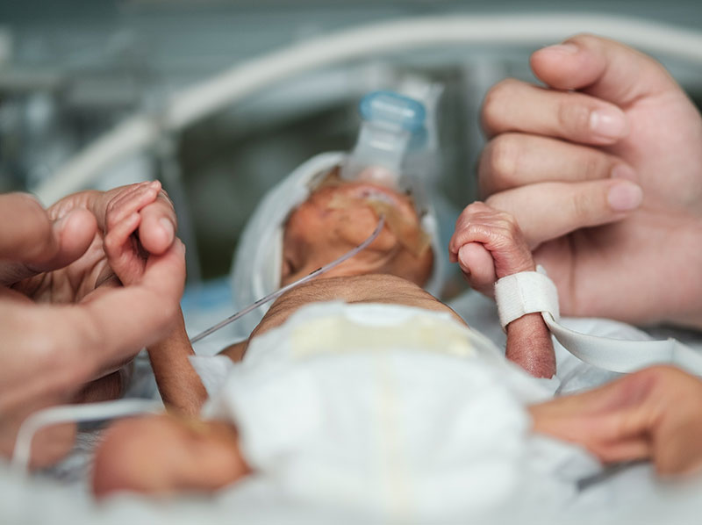
Objectives
Review the composition of lipid injectable emulsions (ILEs) available in the US
Discuss guideline recommendations for parenteral fatty acids and ILE in neonates
Examine data from randomized controlled trials (RCTs) looking at various neonatal outcomes and possible associations with parenteral fatty acid and ILE composition

Slide 4
Overview of Fatty Acids
Arachidonic Acid (AA)
20:4ω-6
C:D (ω minus):
  C – number of carbon atoms
  D – number of double bonds
  ω minus – position of the closest
  double bond relative to the
  terminal methyl group
Major families of unsaturated fatty acids:
  ω-3 Alpha-Linolenic Acid (ALA),
  Eicosapentaenoic acid (EPA),
  Docosahexaenoic Acid (DHA)
  ω-6 Linoleic Acid (LA),
  Arachidonic Acid (AA)
  ω-9 Oleic Acid,
  Eicosatrienoic Acid (Mead Acid)
20
H₃C
14
11
8
5
1
COOH
ω Carbon
Alpha-Linolenic Acid (ALA)
18:3ω-3
H₃C
COOH
Linoleic Acid (LA)
18:2ω-6
H₃C
COOH
Oleic Acid
18:1ω-9
H₃C
COOH

Slide 5

TPN Review
PN is a complex nutrition support intervention
  Prescription drug containing up to 40 ingredients
    Macronutrients, vitamins, trace elements, electrolytes, certain medications
  High-alert medication¹
1. Institute for Safe Medication Practices. ISMP List of High Alert Medications in Acute Care Settings. 2018; https://www.ismp.org/tools/highalertmedications.pdf. Accessed Aug 26, 2019.
Notes:
1.2 micron filter
Multidisciplinary
Takes training and knowledge
Dextrose, AA- infant/premie specific formulas
ILE- we have options now

Slide 6
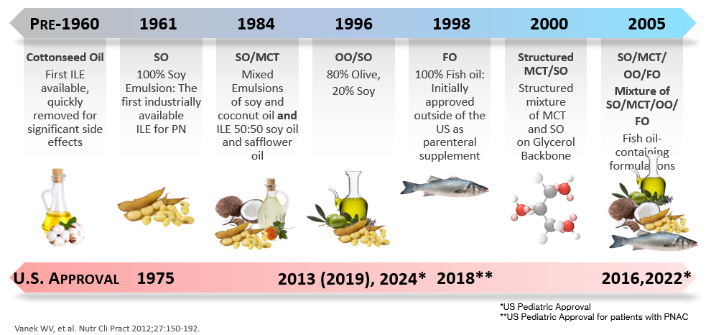
Lipid Injectable Emulsions (ILEs)

Slide 7
ILE Composition
 | Soybean Oil ILE¹ ^{20% and 30% Emulsion} | Soybean Oil ILE² ^{20% Emulsion} | SMOF ILE³ ^{20% Emulsion} | Olive Oil/Soybean Oil ILE⁴ 20% Emulsion | Fish Oil ILE⁵ ^{10% Emulsion}
Oil Source | Soybean Oil 100% | Soybean Oil 100% | Soybean Oil 30% MCT 30% Olive Oil 25% Fish Oil 15% | 80% Olive Oil 20% Soybean Oil | Fish Oil 100%
Indication | Adults and Pediatrics | Adults and Pediatrics | Adults and Pediatrics | Adults and Pediatrics | Pediatrics with PNAC
Fat Composition (Range % by weight )¹⁻⁷
Linoleic | 44-62 | 48-58 | 17.5 | 17.9 | 1.5
Αlpha-Linolenic | 4-11 | 4-11 | 2.25 | 2.35 | 1.1
Eicosapentaenoic | 0 | 0 | 1-3.5 | 0 | 13-26
Docosahexaenoic | 0 | 0 | 1-3.5 | 0 | 14-27
Oleic | 19-30 | 17-30 | 23-35 | 44.3-79.5 | 4-11
Arachidonic | 0 | ND | 0.5 | ND | 0.2-2
Alpha-Tocopherol (mg/L) | 24† | ND | 163-225 | 32 | 150-300
Phytosterol Content⁸ (mcg/mL) (SD) | 381±28.9† | ND | 165±10.4† | 226.83±6.42 –274.38±2.60 | 3.66 ± 0.59
Fresenius Kabi LLC USA. Omegaven. Prescribing Information. 2023.
Fresenius Kabi LLC USA. Intralipid 20%. Prescribing Information. 2023.
B. Braun Medical Inc. Nutrilipid. Prescribing Information. 2023.
Fresenius Kabi LLC USA. SMOFlipid. Prescribing Information. 2023.
Baxter. Clinolipid Prescribing Information. 2024.
Le HD, Meisel JA, de Meijer VE, Gura KM, Puder M. Prostaglandins Leukot Essent Fatty Acids. 2009;81(2-3):165-170.
Vanek VW, Seidner DL, Allen P, et al. Nutr Clin Pract. 2012;27(2):150-192.
Vanek VW, Seidner DL, Allen P, et al. Nutr Clin Pract. 2014;29(6):841.
Notes:
ND- not disclosed
LA and ALA are our EFA
EPA and DHA are the FA we see in fish oil – downstream of O3 – ALA
AA also often mentioned in neonatal health
In yellow are the FO containing lipids we will discuss today

Slide 8
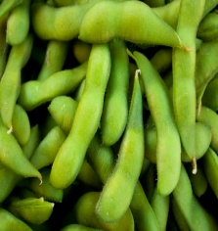
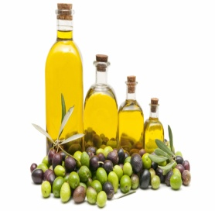
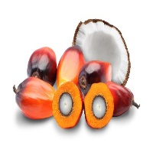

SMOFlipid Indication
Indicated for use in adult and pediatric patients, including term and preterm neonates, as a source of calories and essential fatty acids for parenteral nutrition when oral or enteral nutrition is not possible, insufficient, or contraindicated
  Source of essential (ALA and LA) and conditionally essential (DHA, ARA) fatty acids
  Contains α-tocopherol as an excipient to protect LCT PUFAs from peroxidation
  20% ILE: Provides 2 kcal/mL
  1 g/kg/d provides 0.15 g FO/kg/d
These Photos by Unknown Author is licensed under CC BY-NC-ND
Notes:
Ratio ω-6:ω-3 = 2.5:1 MANUFACTURER DOSING RECOMMENDATIONS: 1-2 g/kg/d (ADULTS) and should not exceed 2.5 g/kg/d
Docosahexaenoic acid, EPA and AA, the metabolites of the essential fatty acids (EFA), ALA and LA, are important structural components of the highly specialized membrane lipids of the human central nervous system and are therefore particularly important for neonates. Thus, AA and EPA are also termed as “the true necessary fatty acids” (Bistrian 2003) or, together with DHA, the “conditionally essential fatty acids” (Le 2009, Kalish 2012).
20% Emulsion; 20gm oils/100mL
CONTAINS in 20 gms: 6 gm SO, 6gm MCT, 5 gm OO, 3 gm FO
10 kcal/gm, 2 kcal/mL

Slide 9
SMOFlipid Contraindications
Known hypersensitivity to fish, egg, soybean, or peanut protein, or to any of the active ingredients or excipients
  Cross reactions have been observed between soybean and peanut oil
Severe hyperlipidemia or severe disorders of lipid metabolism with serum triglycerides >1,000 mg/dL
Notes:
Per PI: Cross reactions have been observed between soybean and peanut oil.
If a patient with a peanut allergy has tolerated soy oil ILE in the past, he should tolerate Smoflipid

Slide 10
SMOFlipid Warnings and Precautions
Clinical Decompensation with Rapid Infusion of Intravenous Lipid Emulsion in Neonates and Infants
  Strictly adhere to daily dosing and maximum infusion rates (0.75 mL/kg/hr [0.15 gm/kg/hr])
Parenteral Nutrition-Associated Liver Disease
Hypersensitivity Reactions including anaphylaxis
Hypertriglyceridemia
Risk of Infections, Fat Overload Syndrome, Refeeding Syndrome
Essential Fatty Acid Deficiency (EFAD)
Aluminum Toxicity
Routine laboratory monitoring recommended
Notes:
Parenteral Nutrition-Associated Liver Disease:
Increased risk in pts who receive PN > 2 wks, especially preterm neonates
Monitor liver tests; if abnormalities occur, consider discontinuation or dosage reduction
Risk of Death in Preterm Infants due to Pulmonary Lipid Accumulation:
Deaths in preterm infants after infusion of intravenous 100% soybean oil ILE have been reported in the literature
Hypersensitivity Reactions:
Monitor for signs or symptoms. Discontinue infusion if reactions occur.
Aluminum Toxicity:
Increased risk in patients with renal impairment and preterm infants
SMOFlipid contains no more than 25 mcg/L of aluminum
> 4 to 5 mcg/kg/d can accumulate aluminum at levels associated with CNS and bone toxicity

Slide 11
SMOFlipid Administration
Central or peripheral vein intravenous infusion
Use a 1.2-micron in-line filter
Use a dedicated infusion line and a non-vented infusion set
Do not use infusion sets and lines containing DEHP, including infusion sets that contain polyvinyl chloride (PVC) components
Can be provided via y-site with 2-in-1 (dextrose-AA) solutions or admixed into a 3-in-1
  Contact Fresenius Kabi Medical Information for stability/compatibility data
After connecting infusion set, start infusion immediately
Complete infusion within 12 hours when y-siting and within 24 hours when used as part of 3-in-1 admixture
Protect the admixed PN solution from light
Notes:
Note that all of these administration recommendations coincide with the ASPEN recommendations for the administration of PN.

Slide 12
SMOFlipid Neonatal and Pediatric Dosing
Patients | Initiation (g/kg/day) | Advance by (g/kg/day) | Goal Dose (g/kg/day) | Max dose (g/kg/day) | Initial Infusion Rate | Maximum Infusion Rate
Birth – 2 years (including preterm and term infants) | 0.5 - 1 | 0.5 - 1 | 3 | 3 | 0.1 – 0.2 mL/kg/hr x first 15-30 minutes | 0.75 mL/kg/hr 0.15 g/kg/hr
2 - < 12 years | 1 - 2 | 0.5 - 1 | 2.5 - 3 | 3 | 0.2 – 0.4 mL/kg/hr x first 15-30 minutes | 0.75 mL/kg/hr 0.15 g/kg/hr
12 – 17 years | 1 | 0.5 - 1 | 2 - 3 | 2.5 | 0.2 – 0.4 mL/kg/hr x first 15-30 minutes | 0.75 mL/kg/hr 0.15 g/kg/hr
Calculating infusion rates:
2 kg pt receiving 3 gm/kg/d SMOFlipid = 6 gm SMOFlipid/day = 30 mL/day
Initial infusion rate: 0.2mL/kg/hr x 2 kg = 0.4 mL/hr x first 15 - 30 minutes
Max infusion rate: 0.75 mL/kg/hr x 2 kg = 1.5 mL/hr
Minimum infusion time, hours: Divide dose in mL (30 mL/d) by max infusion rate (1.5 mL/hr): 30 mL/1.5 mL/hr = 20 hrs
Notes:
Slides 20 and 21 have same dosing information from PI, but differ with calculation examples – pediatric for 10 kg patient, neonatal for 2 kg patient.
Gradually increase to required rate after 30 minutes
The initial infusion rate is a new labeling change per FDA for all ILE

Slide 13
Omegaven: Indication
As a source of calories and fatty acids in pediatric patients with parenteral nutrition-associated cholestasis (PNAC)
Limitations of Use
  Not indicated for prevention of PNAC
  Has not been demonstrated that clinical outcomes observed in patients treated with FO ILE are a result of the ω-6:ω-3 fatty acid ratio
100% Fish Oil Triglycerides
10% Lipid Emulsion
10 g per 100 mL
1.12 kcal/mL
Proprietary - Do Not Distribute. MSL Use Only
Notes:
Explanation of Limitation of Use for not being indicated for PNAC prevention based on RCT that found no difference between groups – Nehra et al 2014: Abstract:
Objective. To assess the safety and efficacy of a fish oil–based intravenous fat emulsion (FIFE) in reducing the incidence of cholestasis in neonates compared with the traditional soybean oil–based intravenous fat emulsion (SIFE). Methods. A double-blind randomized controlled trial was conducted. Nineteen neonates were enrolled (10 SIFE; 9 FIFE). Nutrition assessments and laboratory studies were serially obtained for the duration of PN support or until 6 months’ corrected gestational age. Neurodevelopmental outcomes were assessed at 6 and 24 months’ corrected age. Results. There were no differences between groups in demographic characteristics, with an overall median age of 2 days, gestational age of 36 weeks, and birth weight of 2410 g. There were no differences between groups in baseline laboratory values other than alkaline phosphatase (lower in the FIFE group) or in the duration of parenteral nutrition (PN), amount of enteral intake, or the number of operative procedures. The incidence of cholestasis among enrolled patients was significantly lower than expected, resulting in early study termination and an inability to assess for differences in the incidence of cholestasis. The FIFE was associated with no increased risk of growth impairment, coagulopathy, infectious complications, hypertriglyceridemia, or adverse neurodevelopmental outcomes. No patient developed essential fatty acid deficiency. Conclusion. The FIFE at 1 g/kg/d was well tolerated in the neonates recruited for this study. Given the necessary early termination of this study, a follow-up trial with revised eligibility criteria is necessary to determine whether the provision of FIFE decreases the incidence of PN-cholestasis compared with the traditional SIFE.

Slide 14
Omegaven: Dosing and Administration
Dosing of Omegaven depends on the patient’s energy requirements, which may be influenced by age, body weight, tolerance, clinical status, and ability to metabolize and eliminate lipids
The recommended Omegaven dosage for pediatric patients is 1g/kg/day
  This is also the maximum daily dose
Initiate Omegaven dosing as soon as direct or conjugated bilirubin levels are ≥ 2 mg/dL in pediatric patients expected to be PN-dependent for ≥ 2 weeks
Administer Omegaven until direct or conjugated bilirubin levels are < 2 mg/dL or until the patient no longer requires PN
Proprietary - Do Not Distribute. MSL Use Only

Slide 15
Omegaven Pediatric Dosing
Patients | Initiation (g/kg/day) | Advance by (g/kg/day) | Goal Dose (g/kg/day) | Max dose (g/kg/day) | Initial Infusion Rate | Maximum Infusion Rate
Birth – 17 years (including preterm and term infants) | 0.5 - 1 | 0.5 - 1 | 1 | 1 | 0.2 mL/kg/hr x first 15-30 minutes | 1.5 mL/kg/hr (0.15 g/kg/hr)
Calculating infusion rates:
2 kg pt receiving 1 gm/kg/d Omegaven = 2 gm Omegaven/day = 20 mL/day
Initial infusion rate: 0.2mL/kg/hr x 2 kg = 0.4 mL/hr x first 15 - 30 minutes
Max infusion rate: 1.5 mL/kg/hr x 2 kg = 3 mL/hr
Max infusion time in hours: Divide dose in mL (20 mL/d) by max infusion rate (3 mL/hr):
  20 mL/3 mL/hr = 6.67 hrs (per PI, infuse between 8 - 24 hours), round up to 8 hours
Notes:
Gradually increase to required rate after 30 minutes
The initial infusion rate is a new labeling change per FDA for all ILE

Slide 16
Omegaven: Contraindications
Known hypersensitivity to fish or egg protein or to any of the active ingredients or excipients
Severe hemorrhagic disorders
Severe hyperlipidemia or severe disorders of lipid metabolism with serum triglycerides > 1,000 mg/dL
Proprietary - Do Not Distribute. MSL Use Only
Notes:
Fish oil and egg emulsifier.
Hemorrhagic disorders: refer to section 4: Due to a potential effect on platelet aggregation

Slide 17
Omegaven: Warnings and Precautions
Clinical Decompensation with Rapid Infusion of Intravenous Lipid Emulsion in Neonates and Infants
  Strictly adhere to daily dosing and maximum infusion rates (1.5 mL/kg/hr)
Hypersensitivity Reactions
  Monitor for signs and symptoms; discontinue infusion if reaction occurs
Infection, Fat Overload Syndrome, Refeeding Syndrome, and Hypertriglyceridemia
  Monitor for signs and symptoms; monitor laboratory parameters
Aluminum Toxicity
  Increased risk in patients with renal impairment including preterm infants
Routine laboratory monitoring recommended including for signs and symptoms of EFAD
Proprietary - Do Not Distribute. MSL Use Only
Notes:
Hypersensitivity reactions: For all PN products, the potential for allergy or hypersensitivity for any PN product.
Infection, Fat Overload, Refeeding, and Hypertriglyceridemia: All risks for any PN ILE.
Aluminum toxicity: This is a risk for any patient receiving PN products, but especially for those receiving PN made from products provided in glass bottles (Omegaven is in a glass bottle). Per PI section 5.7: “Omegaven contains no more than 25 mcg/L of aluminum.” “Patients with impaired kidney function, including preterm infants, who receive parenteral levels of aluminum at greater than 4 to 5 mcg/kg/day accumulate aluminum at levels associated with central nervous system and bone toxicity” Since Omegaven is dosed at 1g/kg/d and is a 10% solution, if it in fact contains the maximum allowed of 25 mcg/L a 10kg patient will receive 2.5 mcg/day of Aluminum from Omegaven if these assumptions are true.

Slide 18
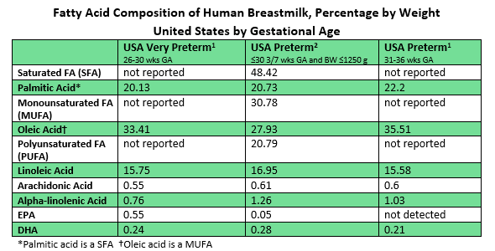
Breastmilk – As Individual as Each Woman
Berseth CL et al. Prostaglandins, Leukotrienes, and Essential Fatty Acids 2014; 91(3): 97–103.
Bokor S et al. Ann Nutr Metab 2008; 51(6): 550–556.

Slide 19
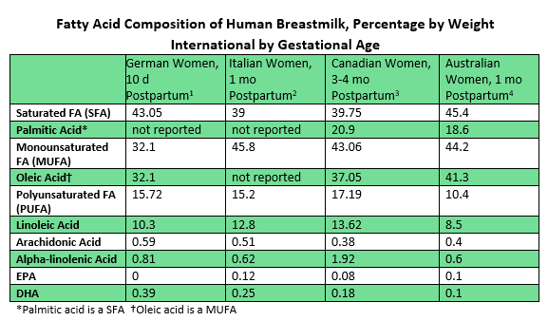
Breastmilk – As Individual as Each Woman

Slide 20
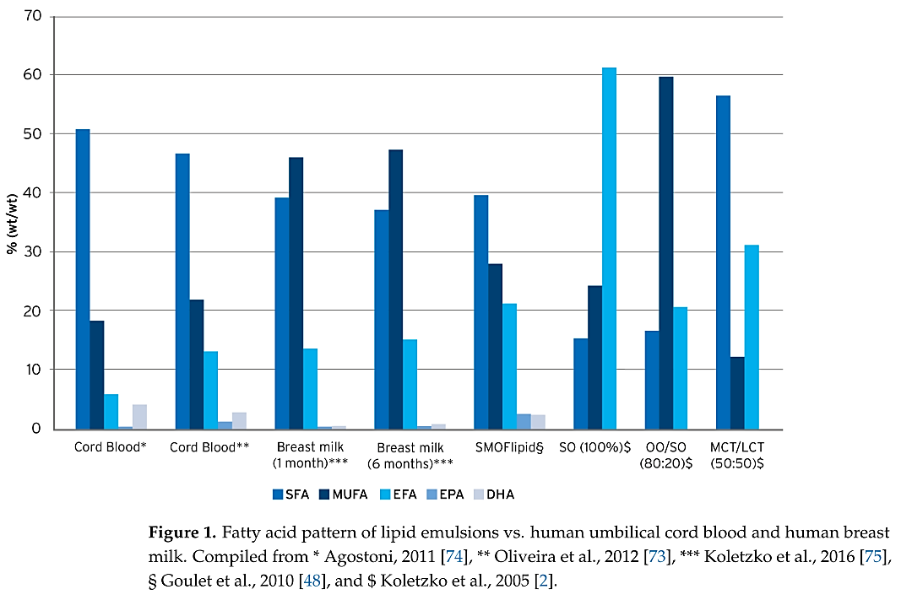
Fatty Acid Composition Comparison:
ILE, BM, Cord Blood
ILE – lipid injectable emulsion
BM – breastmilk

Slide 21
Fatty Acids, EFAD, Triene:Tetraene Ratio
PARENT Essential Fatty Acid
PARENT Essential Fatty Acid
NON-EFA
Omega-3 Fatty Acids
Omega-6 Fatty Acids
Omega-9 Fatty Acids
Alpha-Linolenic Acid (ALA)
18:3 ω3
Linoleic Acid (LA)
18:2 ω6
Oleic Acid (OA)
18:1 ω9
delta-6-desaturase
delta-6-desaturase
Octadecatetraenoic Acid
18:4 ω3
Gamma-Linolenic Acid
18:3 ω6
Octadecadienoic Acid
18:2 ω9
elongase
elongase
Eicosatetraenoic Acid
20:4 ω3
Dihomo-Gamma-Linolenic
Acid 20:3 ω6
Eicosadienoic Acid
20:2 ω9
delta-5-desaturase
delta-5-desaturase
Eicosapentaenoic Acid (EPA)
20:5 ω3
Arachidonic Acid (AA)
20:4 ω6
Eicosatrienoic Acid (Mead Acid)
20:3 ω9
elongase
Docosapentaenoic Acid
22:5 ω3
Docosatetraenoic Acid
22:4 ω6
elongase
24:5 ω3
24:4 ω6
Tetraene
Triene
delta-6-desaturase
24:6 ω3
24:5 ω6
Beta-oxidation
Docosahexaenoic Acid (DHA)
22:6 ω3
Docosapentaenoic Acid
22:5 ω6
Notes:
This shows the parent essential and non-essential fatty acids and their downstream products which are produced by desaturation and elongation.
The enzymes prefer to act on Omega 3, then 6, then 9. When there is a decrease in the essential fatty acids, you will see an increase then in Triene an omega 9 and decrease in tetraene the omega 6 or the T/T ratio which is commonly used to assess essential fatty acid deficiency.
The inflammatory response is affected by fatty acids. Once incorporated into the cell membrane, fatty acids serve as precursors for mediators of inflammation. The ω-6, ω-3, and ω-9 parent fatty acids all compete for the same pool of enzymes for metabolism. Our body preferentially metabolizes ω-3, then ω-6, and then ω-9. In this way, the relative amounts of each parent fatty acid affect production of their downstream products. Mediators derived from downstream ω-6 fatty acids are generally more pro-inflammatory than those derived from downstream ω-3 fatty acids. While this response can be beneficial in some cases, excessive inflammation can be harmful. Notably, ω-3 fatty acids, EPA and DHA, are precursors to pro-resolving mediators and to less pro-inflammatory eicosanoids. The ω-9 fatty acids have relatively few effects on the production of inflammatory mediators, with studies demonstrating an immune-neutral effect.
With Smoflipid’s ω-6 to ω-3 fatty acid ratio of 2.5 to 1, it is less likely to provide precursors to pro-inflammatory mediators in comparison with oils or blends containing higher ω-6 content, such as 100% soybean oil. However, no studies have yet shown directly that the ω-6 to ω-3 fatty acid ratio and the MCT content of Smoflipid can contribute to better clinical outcomes compared to other ILEs.

Slide 22
Fatty Acid Metabolic Pathways in Neonates
Excess EPA may compete with enzymes that convert LA to AA¹
Biosynthesis of DHA and ARA from precursors (ALA and LA, respectively) is low²
Majority of ARA in human breast milk is from maternal stores, not dietary LA conversion²
Impact of EPA on the conversion of LA to AA unclear
Differences in AA levels in RCTs with SMOF ILE vs. comparator ILE
No difference^{3,4,5,6,7,8,9}
↓ARA^{10,11}
Notes:
Deshpande: SMOF vs. OO/SO
Skourouliakou: SMOF vs. SO ILE
Diamond: SMOF vs. SO ILE
Rayyan: SMOF vs. SO ILE
Tomsits: SMOF vs. SO ILE
Vlaardingbroek: SMOF vs. SO ILE
Papandreou: SMOF vs. SO ILE
Diamond: SMOF vs. SO ILE
Naam: SMOF vs. OO/SO ILE
D’Ascenzo: SMOF vs. SO ILE

Slide 23
Fatty Acid Levels in Neonates
DBRCT: OO/SO ILE and SMOF ILE in preterm infants (n = 34)
  Infants receiving PN for > 75% of total calories x ≥ 7 days
  Aim: Compare efficacy and safety of OO/SO ILE and SMOF ILE in preterm infants < 30 weeks GA
    Study ILE duration: 7 days
  Outcomes:
    Primary: LC-PUFA levels, lipid peroxidation (F2-isoprostane levels)
    Secondary: Wt, Ht, Length, culture + sepsis, IVH, LOS, MV duration, mortality, vitamin E levels
  Results:
    LC-PUFA Levels: SMOF ILE higher EPA and Vitamin E and lower F2-isoprostane (all statistically significant)
    No difference: AA, DHA, LA
      AA and DHA decreased in both groups vs. baseline, LA increased in both groups vs. baseline
    Secondary outcomes: No differences between groups
DBRCT- double blinded randomized controlled trial
GA – gestational age
LC-PUFA – long chain polyunsaturated fatty acid
IVH – intraventricular hemorrhage
MV – mechanical ventilation
Notes:
This study highlights that despite increased EPA levels in the SMOF group, ARA levels were comparable between SMOF and OO/SO groups.
Cumulative dose of ILE not different between groups, but daily ILE dose not reported in study
After 7 days, infants all switched to OO/SO ILE which was the standard ILE at this NICU at the time

Slide 24
Fatty Acid Levels in Neonates
Retrospective review: n = 86 ELBW, < 1000 gm, SO ILE vs. SMOF ILE
Mean GA ~26 weeks
BW: 0.8 (0.7 – 0.9) kg SO ILE vs. 0.7 (0.6 – 0.9) kg SMOF ILE, p = 0.04
Primary outcome: ∆ z-scores from birth to discharge
SO: -0.8 (-1.3 - -0.1) vs. SMOF ILE: -0.4 (-1 - 0.3), p = 0.02
Secondary outcomes:
Cholestasis (Cbil > 1 gm/dL): SO ILE: 37% vs. SMOF ILE: 14%, p = 0.03
Cbil > 2 gm/dL: SO ILE: 16% vs. SMOF ILE 9%, p = 0.52
Max Cbil after 14 days of age: SO ILE: 0.8 (0.5–1.4) vs. SMOF ILE 0.4 (0.3–0.6) mg/dL, p = 0.001
Rate of ∆ of Cbil comparable between groups: SO ILE: 0.3 ± 0.04 vs. SMOF ILE: 0.2 ± 0.06 (p = 0.33)
Neonatal comorbidities (ROP, CLD, Late-Onset Sepsis) – no difference between groups, p > 0.99
RBC Membrane polyunsaturated fatty acids (RBCM PUFA) for 1st five weeks of life
SMOF ILE: higher DHA and EPA, lower LA, no difference ALA, higher AA week 2 only, other weeks – no difference
ELBW – extremely low birthweight
ROP – retinopathy of prematurity
CLD – chronic lung disease
Kim ES et al. JPEN 2023; 47(3): 354 – 363.
Notes:
UCLA Children’s
ELBW = < 1000 gm
N = 86 ELBW (43 in each group)
No ∆ in most baseline characteristics
Avg GA ~ 26 wks
BW (kg) significantly ↓ in SMOF vs. SO ILE
0.7 (0.6 – 0.9) vs. 0.8 (0.7 – 0.9)
p = 0.04
PN days: trend to ↓ PN days in SMOF vs. SO ILE
23 (11- 31) vs. 29 (19 – 42), p = 0.08
ILE days: Trend to ↓ ILE days in SMOF vs. SO ILE
22 (11 – 31) vs. 28 (15 – 40), p = 0.08
Day of life full EN: Significantly ↓ in SMOF vs. SO ILE
25 (17 – 34) vs. 33 (24 – 42)
p = 0.02

Slide 25
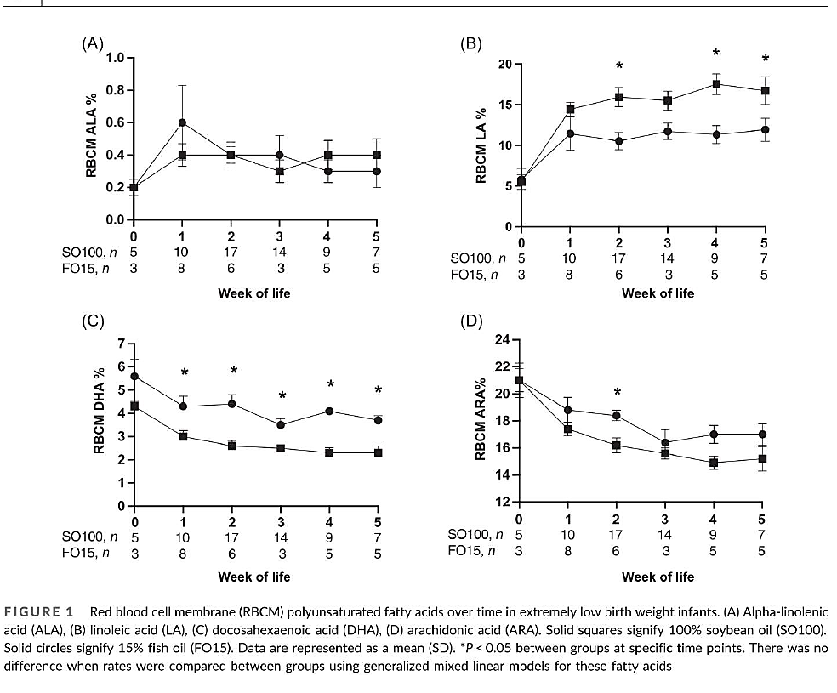
RBC Membrane PUFA Levels in Neonates
SMOF ILE -●- , SO ILE - -,
* denotes statistically significant between groups
ALA: No difference between groups
LA: higher in SO ILE group wks 2, 4, 5
DHA: higher in SMOF ILE group wks 1 - 5
  decrease in both groups vs. baseline
AA: higher in SMOF ILE @ wk 2 only
  decrease in both groups vs. baseline
EPA: higher in SMOF ILE vs. SO ILE @ all points
Kim ES et al. JPEN 2023; 47(3): 354 – 363.
Notes:
SMOF – circles
SO – squares
Bottom line – ARA and DHA decrease after birth, increased EPA did not cause a larger decrease in ARA vs. SO ILE
ARA no different between groups despite increased LA in SO ILE group.
SO ILE did not lead to an increase in ARA despite higher LA levels
ARA may not be as sensitive to LA and EPA levels as hypothesized?
Despite increased EPA at all time points, no decrease in ARA and no increase in adverse clinical outcomes

Slide 26
SMOF ILE: EFAD Data
 |  | SO ILE n = 78 | SMOF ILE n = 83
Triene: Tetraene Ratio |  | % (n)
Baseline Day 1 | <0.05 | 78.2% (61) | 86.7% (72)
 | >=0.05 <0.20 | 11.5% (9) | 6% (5)
 | >=0.20 <0.40 | 0% (0) | 1.2% (1)
 | >=0.40 | 0% | 0%
 | Not assessed | 10.3% (8) | 6% (5)
Day 29 | <0.05 | 34.6% (27) | 32.5% (27)
 | >=0.05 <0.20 | 1.3% (1) | 1.2% (1)
 | >=0.20 <0.40 | 0% | 0%
 | >=0.40 | 0% | 0%
 | Not assessed | 64.1% (50) | 66.3% (55)
EoT initial Treatment phase | <0.05 | 79.5% (62) | 83.1% (69)
 | >=0.05 <0.20 | 2.6% (2) | 2.4% (2)
 | >=0.20 <0.40 | 0% | 0%
 | >=0.40 | 0% | 0%
 | Not assessed | 17.9% (14) | 14.5% (12)
EoT Extension phase | <0.05 | 12.8% (10) | 13.3% (11)
 | >=0.05 <0.20 | 1.3% (1) | 1.2% (1)
 | >=0.20 <0.40 | 0% | 0%
 | >=0.40 | 0% | 0%
 | Not assessed | 85.9% (67) | 85.5% (71)
Biochemical EFAD cutoff: T/T Ratio ≥ 0.2
Clinical EFAD cutoff: T/T Ratio ≥ 0.4
EFAD – essential fatty acid deficiency
Notes:
Multicenter RCT in US (pre-publication, NCT02579265)
N = 204 infants/children with no evidence of EFAD – chart demonstrates T/T ratios all < 0.2 (biochemical EFAD cutoff) while on SMOF and SO ILE

Slide 27
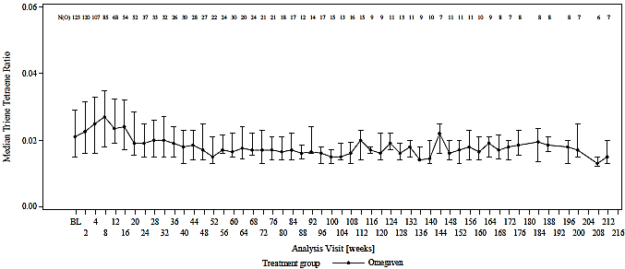
100% FO ILE : No EFAD, N=123
No clinical signs of EFAD reported when dosed appropriately¹
No sign of EFAD (T:T ≥ 0.2) in Omegaven patients for up to 216 weeks¹
Median T:T ratio 0.02 (IQR 0.01 – 0.03)²
EFAD: Essential Fatty Acid Deficiency
Notes:
Data – from BCH – discussed in PI section 6.1
Only 7 patients at 216 weeks
Other studies show no EFAD next slide

Slide 28
100% FO ILE Composition: EFAD Concerns?
What are “essential,” parent EFAs (LA and ALA) or downstream products (AA, DHA)?
  Murine models demonstrate ≥ 2% of kcal from DHA and ≥ 0.1% of kcal from AA prevent clinical and biochemical EFAD¹ and reverse biochemical EFAD²
  Murine models demonstrate retroconversion of ARA to LA³
Human studies demonstrate normal T/T ratios in infants and children on FO ILE dosed at 1 g/kg/d⁴⁻¹⁰
  Boston Children’s Hospital, UCLA, Children’s National Medical Center (D.C.)
  Case reports of higher doses of FO ILE required for adequate growth and prevention of EFAD¹¹
Notes:
Case reports = the exception not the rule
DHA and EPA (ω-3 fatty acids) are considered to be important
for a healthy development of the infant due to their special physiological roles1,2
May be considered conditionally essential for growth
and development3,4
Important structural elements of cell membranes2
DHA is necessary for the normal development
of the central nervous system and retina2,3
Primary precursors of the very long chain
fatty acids synthesized in the retina2

Slide 29
Current Guidelines for PN in Preterm Infants – ASPEN 2023
Question 4
Compared with lower ILE doses, do higher ILE doses improve growth outcomes?
Recommend daily advancement of ILE to goal dose 3/g/kg/d independent of ILE type. Ensure adequate EFA provision.
Question 5
Compared with an ILE containing 100% SO as the sole oil source, is altering the ILE composition by reducing the proportion of SO associated with growth outcomes?
No specific ILE recommended for enhanced growth.
Question 6
Compared with a higher dose of macronutrients (AA, dextrose, ILE), does a lower dose of macronutrients reduce incidence of PNALD?
Do not recommend routinely reducing macronutrient doses to prevent PNALD.
Question 7a
Question 7b
Question 8
Question 9
Compared with an ILE containing 100% SO as the sole oil source, does a reduction in SO using any multicomponent‐oil ILE reduce the incidence of PNALD?
Compared with an ILE containing 100% SO as the sole oil source, does reducing SO using a multicomponent‐oil ILE that includes FO reduce the incidence of PNALD?
Does reducing the dose of ILE reduce levels of unbound bilirubin?
Does a reduced dose of ILE reduce the risk of sepsis?
QoE: Very Low
SoR: Strong
QoE: Very low
SoR: Strong
QoE: Very low
SoR: Strong
No specific ILE recommended for prevention of PNALD.
QoE: Low
SoR: Strong
No specific ILE recommended to prevent PNALD. Need further studies on potential association of ILE with FO and ROP severity.
QoE: Low
SoR: Strong
Unable to recommend specific ILE to reduce unbound bilirubin levels. Suggest further research.
QoE: Very low
SoR: Strong
We recommend against a dose reduction of ILE to prevent sepsis
QoE: Very low
SoR: Strong
QoE – quality of evidence
SoR – strength of recommendation
PNALD – parenteral nutrition associated liver disease
Robinson DT, Calkins KL et al. JPEN 2023; 47(7): 830 – 858.
Notes:
ASPEN released some guidelines with a limited scope in 2023. The purpose of this guideline is to systematically evaluate the quality of relevant literature and provide recommendations on key clinical questions pertaining to the clinical practice of providing PN in preterm infants. The focus of this guideline is on preterm infants born without congenital diseases requiring surgery and does not address preterm infants who have been diagnosed with PN-associated liver disease (PNALD).
This guideline's target population of preterm infants is expected to advance to full enteral nutrition without difficulty except in the event of necrotizing enterocolitis (NEC)
Few studies met strict criteria, and sometimes secondary outcomes were used to make guidelines hence low evidence for all of them.
GRADE
Quality – ability of the available evidence to answer the population, intervention, control, and outcomes (PICO) questions
Recommendation Strength – describes the panel’s assessment of the potential harm vs. benefit of the recommendation independent of the evidence quality.
Often the guideline is based on secondary or not even secondary outcomes!
Power?
Multiple variables adjusted
Study heterogeneity
All receiving enteral in increasing amounts
Duration of studies may not be long enough to see effects

Slide 30
Clinical Outcomes in Neonates
Growth
Parenteral nutrition associated cholestasis – PNAC
Retinopathy of prematurity – ROP
Bronchopulmonary dysplasia – BPD
Sepsis
Neurodevelopmental outcomes – NDO
Notes:
Now we’ll talk about some specific clinical concerns in neonates and review available literature on the effect of ILE, especially those with FO, on these outcomes.

Slide 31
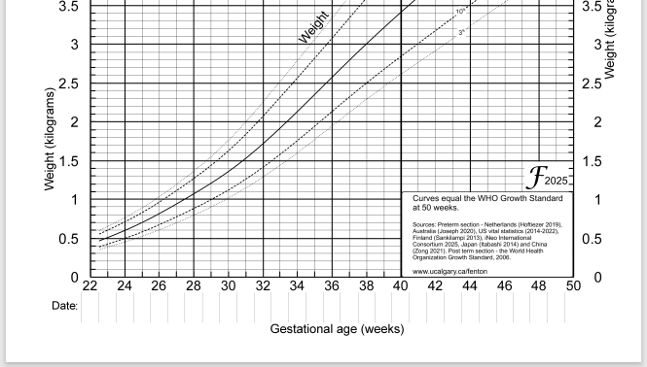
Growth
https://www.ucalgary.ca/resource/preterm-growth-chart/preterm-growth-chart
Notes:
Now we’ll talk about some specific clinical concerns in neonates and review available literature on the effect of ILE, especially those with FO, on these outcomes.

Slide 32
SMOF and Growth
Neonatal and pediatric studies: Growth with SMOF ILE adequate and comparable to comparator ILE¹⁻¹⁶
Multicenter, RCT (n = 152 preterm and term neonates, 9 infants (29 – 153 days of age)¹
SMOF ILE adequate and comparable to SO ILE
Meta-analyses: No difference in growth between SMOF ILE and comparator ILE in pre-term¹⁰, late-preterm and term infants¹⁴, pediatric hospitalized patients¹⁵, and children with intestinal failure¹⁶
SMOFlipid Prescribing Information. Fresenius Kabi USA LLC. May 2023
Skouroliakou M, Konstantinou D, Koutri K, et al Eur J Clin Nutr. 2010;64(9):940-947..
Skouroliakou M, et al. Nutr Clin Pract. 2012;27(6):817-824.
Savini S, D'Ascenzo R, Biagetti C, et al. Am J Clin Nutr. 2013;98(2):312-318.
Tomsits E, Pataki M, Tolgyesi A, Fekete G, Rischak K, Szollar LJ Pediatr Gastroenterol Nutr. 2010;51(4):514-521.
Rayyan M, et al. JPEN J Parenter Enteral Nutr. 2012;36(1 Suppl):81S-94S.
Deshpande G, Simmer K, Deshmukh M, Mori TA, Croft KD, Kristensen J. J Pediatr Gastroenterol Nutr. 2014;58(2):177-182.
D'Ascenzo R, Savini S, Biagetti C, et al. Clin Nutr. 2014;33(6):1002-1009.
Ariyawangso U, Puttilerpong C, Ratanachu-ek S, Anuntkosol M. The Thai Journal of Pharmaceutical Sciences. 2014;38(4):156-209.
Kapoor V, Glover R, Malviya MN. Cochrane Database Syst Rev. 2015;12:CD009172.
Vlaardingerbroek H, Vermeulen MJ, Carnielli VP, Vaz FM, van den Akker CH, van Goudoever JB. J Pediatr Gastroenterol Nutr. 2014;58(4):417-427.
Repa et al. J Pediatr 2018; 194: 87-93
Costa S. et al. JPEN 2021;45(1):94-101
Kapoor V, Malviya MN, Soll R. Cochrane Database Syst Rev. 2019;6:CD013171.
Edward RR et al. Clinical Nutrition 2018; 37(3): 765-83.
Seida JC et al. JPEN 2013; 37(1): 44 – 55.

Slide 33
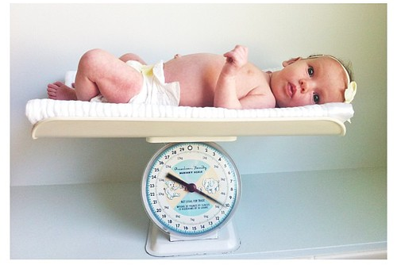
Omegaven and Growth
Lam et al. 2014 DBRCT comparing FO ILE (n=7) vs SO ILE (n=9) for PNAC¹
  1.5 g/kg/d (off label)
  Growth was a secondary outcome
  Weight increased faster in FO vs SO (128 vs. 83 g/week, p = 0.02)
  Trend to increase HC in FO vs SO (0.49 vs. 0.33 cm/week, p = 0.06)
Nehra et al. 2013 Interim Analysis of DBRCT comparing FO ILE (n=9) vs SO ILE (n=10)³
  1 g/kg/d: on label FO, minimization SO
  Primary outcome was cholestasis. Terminated early due to low incidence of cholestasis.
  Growth was a secondary outcome: no significant differences in wt-age, length-age, HC-age z scores.
Lee et al. 2020 Retrospective analysis comparing FO ILE (n=15) vs SMOF ILE (n=32) in IFALD²
  1 g/kg/d: on label FO, minimization SMOF
  Wt and HC at 6 and 12 m PMA not different between study population and controls
  Median wt of 1700 g at initiation of Omegaven to 2800 g at the discontinuation after 6 weeks
  Improvement from < 10th percentile range to 10~25th percentile
Raphael et al. 2020 Retrospective analysis of prospective data FO ILE (n=138) vs SO ILE (n=108) for growth in IFALD⁴
  Mean FO dose 0.8 g/kg/d (range 0.1 – 1.1); Mean SO dose 2.2 g/kg/d (range 0.6 – 3.2)
  FO showed comparable growth to SO and improved growth up to 24 months of age
IFALD – intestinal failure associated liver disease
HC – head circumference
PMA – postmenstrual age
Lam HS et al. Neonatology 2014;105(4):290-6
Lee S et al. J Clin Med 2020;9(11):3393
Nehra D et al. JPEN 2014;38(6):693-701
Raphael BP et al. J Pediatr Gastroenterol Nutr 2020;70(2):261-268
This Photo by Unknown Author is licensed under CC BY
Notes:
Repa et al. J Pediatr 2018; 194: 87-93
Many studies look at SMOF and growth, fewer with 100% FO as fewer patients need 100% FO per the indication. Here are a few studies looking at appropriate growth, and the studies used for FDA approval will be discussed later.
Nutrition research difficulties, esp in neonatal population: small study size, ethics of RCTs, confounding variables, changing practice and using historical controls
Also getting EN- Nehra 60kcal/day per group
Rapheal- were not on FO this whole time, inclusion required at least 4 weeks of PN tx
Lam HS, Tam YH, Poon TC, Cheung HM, Yu X, Chan BP, Lee KH, Lee BS, Ng PC. A double-blind randomised controlled trial of fish oil-based versus soy-based lipid preparations in the treatment of infants with parenteral nutrition-associated cholestasis. Neonatology. 2014;105(4):290-6. doi: 10.1159/000358267. Epub 2014 Feb 26. PMID: 24576844.
Lee S, Sung SI, Park HJ, Chang YS, Park WS, Seo JM. Fish Oil Monotherapy for Intestinal Failure-Associated Liver Disease on SMOFlipid in the Neonatal Intensive Care Unit. J Clin Med. 2020 Oct 23;9(11):3393. doi: 10.3390/jcm9113393. PMID: 33113902; PMCID: PMC7690741.
Nehra D, Fallon EM, Potemkin AK, Voss SD, Mitchell PD, Valim C, Belfort MB, Bellinger DC, Duggan C, Gura KM, Puder M. A comparison of 2 intravenous lipid emulsions: interim analysis of a randomized controlled trial. JPEN J Parenter Enteral Nutr. 2014 Aug;38(6):693-701. doi: 10.1177/0148607113492549. Epub 2013 Jun 14. PMID: 23770843; PMCID: PMC4635445.
Raphael BP, Mitchell PD, Gura KM, Potemkin AK, Squires RH, Puder M, Duggan CP. Growth in Infants and Children With Intestinal Failure-associated Liver Disease Treated With Intravenous Fish Oil. J Pediatr Gastroenterol Nutr. 2020 Feb;70(2):261-268. doi: 10.1097/MPG.0000000000002551. PMID: 31978030.

Slide 34

Parenteral Nutrition Associated Cholestasis
PNAC
sad-suffering-sick-cute-human-liver-organ-asks-for-help-character-flat-cartoon-illustration-icon-design-isolated-on-white-backgound-suffering-unhealthy-liver-character-concept-vector.jpg (1920×1920)

Slide 35
Parenteral Nutrition Associated Cholestasis
PNAC is generally defined as direct/conjugated bilirubin ≥ 2mg/dL in patients on PN for ≥ 14 days
  Overall incidence in infants on PN ≥ 14 days, 28.2%
    ELBW and VLBW is 25.2%
    Can progress to fibrosis, cirrhosis, portal hypertension, ESLD (end stage liver disease)
    Risk of PNAC increases with duration of PN, prematurity, low birth weight, intestinal failure, lack of EN
Prevention vs. Treatment
EN – enteral nutrition

Slide 36

PNAC – Prevention
Cycling PN, use of DEHP-free tubing, enteral feeds
No ILE, including 100% FO, is indicated for the prevention of PNAC
Di (2-Ethylhexyl) phthalate (DEHP) is a plasticizer used to make PVC soft and flexible.
Notes:
No ILE has an FDA indication for PNAC prevention, but there is data looking at incidence of PNAC with varying ILEs. These studies are difficult as most patients are also on some amount of EN, as that is the goal- to wean PN to EN/oral! Other comorbidities and contributing factors are also difficult to tease out, especially in the small sample sizes associated with nutrition studies in neonates especially.

Slide 37
PNAC/IFALD/Cholestasis/Dbil Incidence with SMOF ILE
Randomized controlled trials (RCT), N = 14, n = 1610 infants¹⁻¹⁴
  Infants (Pilot RCT, n = 24 infants): SMOF ILE vs. SO ILE⁴
    Significant ↓ Cbil (MD -3.45 mg/dL, p = 0.03)*, more likely to reach Cbil = 0 mg/dL (HR 10.6, 95% CI 1.3- 86.9, p = 0.006) *Excluding outlier
  ELBW infants (RCT, n = 230, 223 analyzed ITT): SMOF ILE vs. SO ILE¹
    NS ↓ cholestasis (36% ↓ PNAC, p = 0.2)
  VLBW infants (RCT, n = 67): SMOF ILE vs. OO/SO ILE²
    Significant ↓ cholestasis (0% vs. 18.2%, p = 0.011)
  VLBW infants (RCT, n = 465): SMOF ILE vs. MCT/SO ILE⁵ (MCT/SO n/a in the US)
    Significant ↓ PNAC (13.7% vs. 21.2%, p = 0.032)
  VLBW infants (RCT, n = 101): SMOF ILE vs. SO ILE⁶
    NS ↓ PNAC ( 8% vs. 20%, p = 0.091)
  RCTs with no significant difference in PNAC between groups (N = 7 studies, n = 699)^{7 –14}
NS: Non-statistically significant
MD: Mean difference
HR: Hazard ratio
References on next page
Notes:
Of the RCT with NS difference in PNAC, PNAC was not the primary outcome in any of those studies (not powered to detect a difference in PNAC).

Slide 38
PNAC/IFALD/Cholestasis/Dbil Incidence with SMOF ILE References
Repa A, Binder C, Thanhaeuser M, et al. J Pediatr. 2018; 194: 87-93.
Yildizdas HY, etal. Pediatr Neonatol. 2019;60(4):359-367.
Huff KA et al. JPEN J Parenter Enter Nutr 2023; DOI: 10.1002/jpen.2483.
Diamond IR et al. JPEN J Parenter Enteral Nutr 2017 41(5): 866-77.
Yang Q, Kong J, Bai RM et al. Eur J Clin Nutr 2023; 77: 823 – 832.
Costa S et al. JPEN 2021; 45(1): 94 – 101.
Savini S, D’Ascenzo R, Biagetti C. et al. Am J Clin Nutr 2013; 98(2): 312- 8.
Ozkan H, Koksal N, Dorum BA et al. Pediatr Int 2019; 61(4): 388 – 92.
D’Ascenzo R, Savini S. Biagetti C et al. Clin Nutr 2014; 33(6): 1002-9.
Vlaardingerroek H, Vermuelen MJ, Carnielli VP et al. J Pediatr Gastroenterol Nutr 2014; 58(4): 417-27.
Hsiao CC et al. Clin Nutr 2019;38(3):1045-1052.
Najm S, Lofqvist C, Hellgren G et al. Clin Nutr 2017; 20: 17-23.
Skouroliakou M, Konstantinou D et al. Eur J Clin Nutr 2010; 64(9): 940 -7.
Beken S, Dilli D, Fettah ND et al. Early Hum Dev 2013; 90(1): 27 – 31.

Slide 39
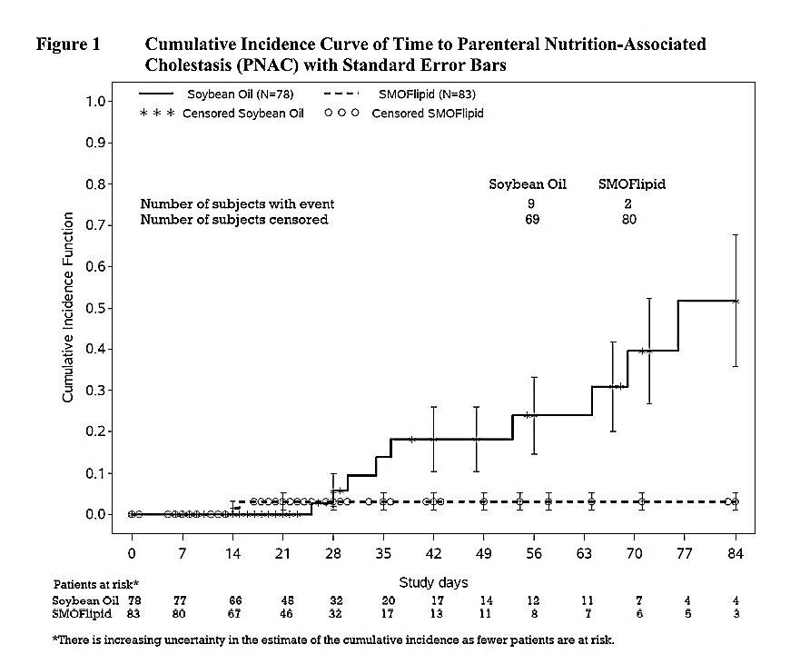
Multicenter RCT (US): N = 161, PNAC Incidence^{1,2}
Results¹
Overall, few with c. bili > 2 mg/dL during first 28 days of treatment
41% risk reduction of PNAC in SMOF ILE group vs. SO ILE group (NS)
  RR 0.59 (95% CI 0.09 – 3.76)
Risk of PNAC in No NEC group ↓ 68% (NS)
Trend to ↑ PNAC in NEC group (n = 1 vs. n = 0) (NS)
  Small n, # patients with c. bil > 2 mg/dL too small to draw meaningful conclusions re: patients with NEC vs. no-NEC
NEC – necrotizing enterocolitis
Notes:
This cumulative incidence graph is in the SMOFlipid Prescribing Information Adverse Event section. It is showing results from an RCT comparing SMOFlipid to SO ILE in neonates and infants over an 84 day period.
This graph shows that for the first two weeks, no difference in PNAC incidence, but after four weeks, curves diverge and we see a higher incidence of PNAC with SO vs. SMOF.
NS because incidence of PNAC so low but this graphic demonstrates lower incidence of PNAC in SMOFlipid when provided long-term (ie >=4 weeks).
Overall, few patients had confirmed conjugated bilirubin values > 2 mg/dL during the first 28 days of study treatment (Table 12-1). The risk ratio of 0.59 (95% CI: 0.09, 3.76) indicates that patients receiving Smoflipid had a 41% reduction in the risk of having conjugated bilirubin values > 2 mg/dL compared to patients receiving Intralipid during the first 28 days of study treatment. However, based on the 95% CI, this risk reduction is not considered statistically significant. Furthermore, the risk of having conjugated bilirubin values > 2mg/dL for No NEC patients receiving Smoflipid is reduced up to 68%, whereas for the NEC patients the trend is in the opposite direction with the risk having a tendency to be higher in the Smoflipid treatment group (1 patient) than in the Intralipid group (0 patient).
Nevertheless, the sample size and the number of patients with values > 2 mg/dL was too small to draw meaningful conclusions for patients with the underlying disease NEC. All occurrences of confirmed conjugated bilirubin values > 2 mg/dL during the first 28 days were seen during Stage 1 of the study, i.e. patients completing the study prior to the interim analysis, and none were seen during Stage 2 of the study, i.e. patients completing the study after the interim analysis.

Slide 40
PNAC Incidence with SMOF ILE: Meta-Analysis of RCT
20 RCT, n = 1904 neonates of median GA 25.5 – 34.5 weeks receiving either SMOF ILE or non-fish oil containing ILE
Outcomes: Cholestasis, BPD, NEC, mortality, PDA, ROP, IVH, sepsis, LOS
Results:
  Cholestasis: Significant decrease in cholestasis in SMOF ILE arm vs. control
    RR 0.65, 95% CI: 0.48 – 0.87, p = 0.004, I² = 0%
  No difference between groups: BPD, NEC, mortality, ROP, PDA, IVH, sepsis, LOS
  Subgroup analysis of neonates < 28 weeks GA:
    Significant decrease in cholestasis in SMOF ILE arm vs. control (RR 0.59, 95% CI 0.4 – 0.87, p = 0.01, I² = 0%)
    No difference in other clinical outcomes except ↓ PDA in SMOF ILE arm
      RR 0.88, 95% CI 0.79 – 0.99, p = 0.04, I² = 0%
  Subgroup analysis of infants receiving PN for > 14 days:
    Significant decrease in cholestasis in SMOF ILE arm vs. control (RR 0.72, 95% CI 0.45 – 0.84, p = 0.01, I² = 0%)
    No differences in other clinical outcomes
LOS – length of stay
RR – relative risk
CI- confidence interval
Notes:
Cholestasis was consistently better in FO containing ILE overall and in multiple subgroups
You can see no other differences were seen, although in individual studies this may differ.
The heterogeneity was minimal, perhaps nonexistent as you can see with the I2 value
Again, many variables may be at play especially enteral intake.
For PNAC Forest plot, n = 12 studies included (n = 724)
N = 945 SMOFlipid N = 959 – other ILE (included Intralipid or 100% SO ILE (13), Clinoleic (5), MCT/LCT (4) - overlap as one study (Savini) evaluated 5 different ILE)
Inclusion criteria: RCT, infants receiving PN with SMOFLipid as intervention arm, at least one clinical outcome such as PNAC, ROP, BDP, sepsis, IVH, LOS, NEC
Exclusion criteria: Non-RCT, animal or in-vitro studies, studies without at least one clinical outcome, duplicates, not full text, not in English
# PN days: 7 – 59.5

Slide 41
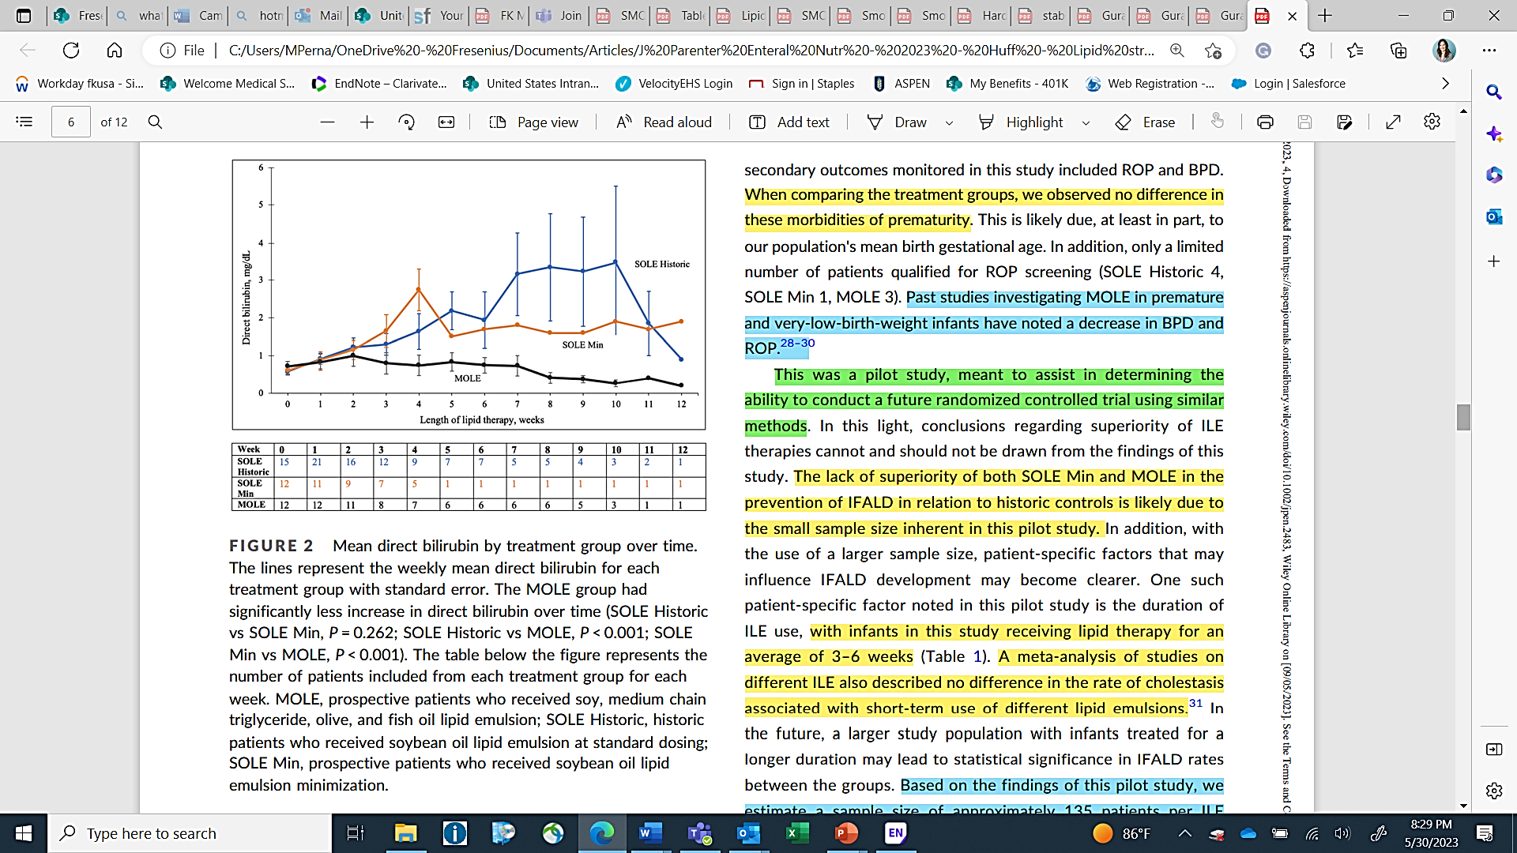
Preventing IFALD in Surgical Neonates - 2023
SO minimization (1 gm/kg/d) vs. SMOF (3 gm/kg/d) historic controls (SO 2-3 gm/kg/d)
  N = 24 prospective + 24 historic cohort
Prospective pilot study
No difference in rate of IFALD
  29% SO historic, 25% of SO min, 8% SMOF (not significant)
SMOF Significant Findings
  Decreased rate of change direct bilirubin (dbil) over time
  Decreased dbil at study completion
  Increased caloric intake with SMOF ILE
  No EFAD reported
Huff K, Cruse W, Vanderpool C. J Parenter Enteral Nutr. 2023;47:482‐493. doi:10.1002/jpen.2483
Notes:
IFALD in this study defined as Dbil > 2 mg/dL x 2
This study was conducted in US, and it is the only study we are aware of that compared SMOFlipid at 3 gm/kg/d to SO ILE at 1 gm/kg/d

Slide 42
PNAC – Treatment
Practices
  ILE Minimization
  Ursodiol
  Increase EN as tolerated
  Other?
Omegaven is the only ILE indicated for patients with PNAC
  As a source of calories and fatty acids in pediatric patients with parenteral nutrition-associated cholestasis (PNAC)¹
  Notable dosing difference compared to other ILEs (1g/kg/d vs. 3g/kg/d)
    What about growth? Nutrition provision? EFAD (already discussed)?
1. Omegaven Prescribing Information. Fresenius Kabi USA, LLC. 2025.
Notes:
For other? Ask audience if they have heard or tried anything else

Slide 43

Omegaven: 100% Fish Oil
Nutrition Provision
Growth
1. Omegaven Prescribing Information. Fresenius Kabi USA, LLC. 2025.
Notes:
For other? Ask audience

Slide 44
FO ILE: Initial FDA Approval Studies
 | Subjects | Intervention (n=82) | Comparison (n=41)
Boston Children’s Hospital (BCH) | <2 years, expected to require PN for ≥30 d, DBil ≥ 2 mg/dL, and lacked response to standard therapies for IFALD | FO ILE at 1g/kg/d, IV until Dbil <2 mg/dL or no longer requiring PN Received FO ILE between 2004 – 2012 | SO ILE at a target dose of ≤3 g/kg/d Received SO ILE between 1999 - 2012 at BCH, TCH, or UCLA
Texas Children’s Hospital (TCH) | >14 days and <5 years, expected to require PN ≥14 days, and receiving at least 20% of kcal from PN
Design: Retrospective analysis of prospectively collected data for patients on FO ILE compared to historical controls on SO ILE
Notes:
Although a randomized study design would have been preferred, ethical considerations and recruitment challenges made such a study impossible. As a result, a pair-matched study design with historical controls was used. This approach has been employed for other rare and potentially life-threating diseases.
All FOLE recipients received SOLE before being switched to FOLE; no recipient received FOLE as their initial source of intravenous lipid emulsion
Selection Criteria:
Signed informed consent form for Omegaven patients
PN-dependent and expected to require PN for ≥ 30 days (or ≥ 14 days for HC patients from TCH or UCLA).
Confirmed PNAC (direct/ conjugated bilirubin [DBil] ≥ 2 mg/dL)
Prior use of standard therapies to prevent progression of liver disease (Omegaven patients only)
No other known cause of chronic liver disease in the absence of intestinal failure.
No multi-organ or renal failure
No inborn error of metabolism at the time of enrollment
No major cardiac anomaly with hemodynamic instability
BCH, UCLA: ≤ 2 years / TCH: ≤ 5 years of age
No known cirrhosis confirmed by pathology
No international normalized ratio > 2.0.
No congenitally lethal condition (e.g., trisomy 13).
No severe bleeding that could not be managed with routine measures.
No allergy to eggs and/or shellfish.
(Fish families: Engraulidae, Carangidae, Clupeidae, Osmeridae, Scombridae, Ammodytidae)
No portal vein thrombosis or reversal of portal flow by abdominal ultrasound at the time of consent
No pregnant patients
Not enrolled in another interventional trial
Patient’s survival extremely unlikely even if cholestasis improved

Slide 45
Pair-Matched Data: Nutrition Provision
Nutrition Received During Treatment (through resolution of cholestasis)*
FO ILE → received a greater % of caloric intake from PN longer
SO ILE → transitioned more quickly to EN
 | FO ILE | SO ILE
Median Duration of Treatment (days) | 82.5 | 111.0 | P = .776
Lipid Dose (g/kg/d) | 0.92 (0.88, 0.96) | 2.31 (1.82, 2.69) | P < .001
Dextrose Dose (g/kg/d) | 15.61 (11.12, 19) | 12.37 (9.23, 12.71) | P = .010
Total PN Calories (kcal/kg/d) | 71.19 (56.27, 85.86) | 72.80 (59.46, 88.05) | P = .791
Enteral Calories (kcal/kg/d) | 14.06 (3.02, 32.89) | 23.12 (10.51, 37.31) | P = .162
*Values represent median (IQR)
Notes:
The median duration of treatment was 82.5 days in FOLE recipients and 111.0 days in SOLE recipients
FOLE recipients received a lower lipid dose compared with SOLE recipients.
However, FOLE recipients received higher dextrose doses compared with SOLE.
Thus, total PN calories were similar for both groups.
There was also no statistically significant difference between groups in enteral calories
FOLE recipients received more PN support longer, and those in the SOLE group transitioned more quickly to enteral nutrition.

Slide 46
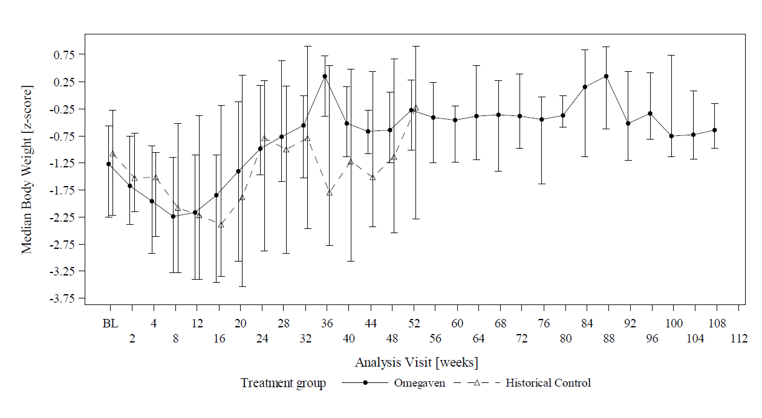
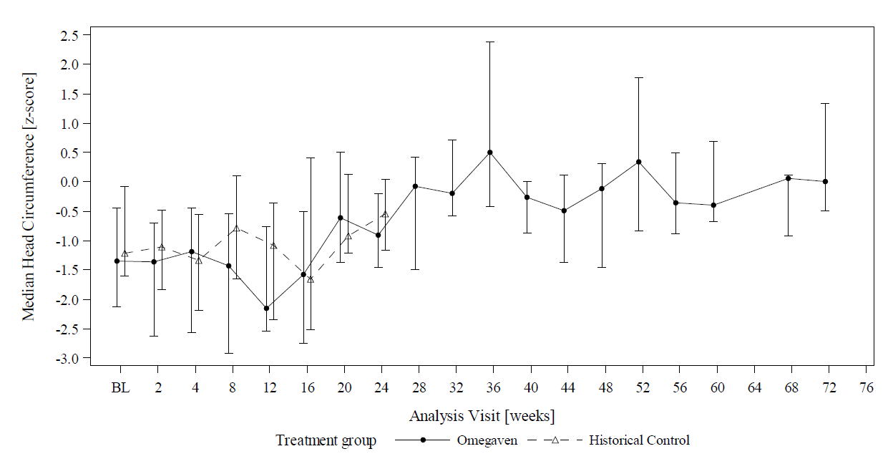
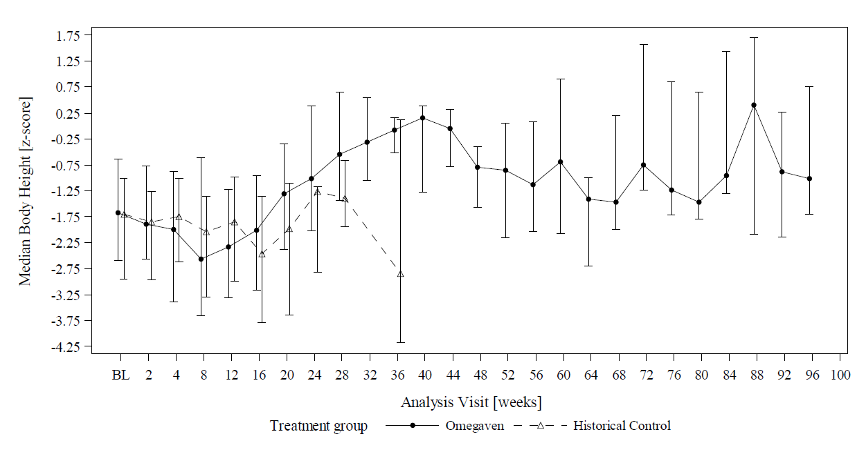
Pair-Matched Data: Growth Outcomes
Weight: from week 28, FO ILE patients had median z-scores between -1.0 and 1.0 indicating age-appropriate growth
  No statistical difference for any of the time points for weight for age
Height: from week 28, FO ILE patients had median z-scores between -1.0 and 1.0 at most visits
No statistical difference between groups for changes in head circumference
Notes:
This data is in addition to what we looked at earlier. This is from the studies used to gain FDA approval for OMG.
Based on the ANCOVA analysis, there were no significant differences between the FOLE and SOLE group for changes from baseline in age-adjusted body weight, height/length, or head circumference at the time of resolution of cholestasis or at the end of study
The repeated measures analyses for body weight, height/length and head circumference provided similar results. Similar trends in growth measures were observed when the time course of growth measures were plotted based on chronological age

Slide 47
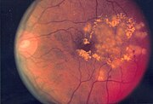
ROP
Retinopathy
of
Prematurity
This Photo by Unknown Author is licensed under CC BY-SA
Notes:
These look at SMOFlipid as that is an “everyday” lipid, and OMG is really for PNAC only.

Slide 48
ROP and ILE – Clinical Trials
Najm et al 2017: RCT (SMOF ILE vs. OO/SO ILE, n = 90 ELBW infants, < 28 weeks GA), 78 infants completed study
  All infants received concomitant EN with LC-PUFA supplementation
  Outcomes: LC-PUFA profiles (DHA, EPA, AA, AA/DHA ratio), ROP, BPD, NEC, PDA, sepsis, growth
  Results – Clinical Outcomes: No significant differences between groups
    ROP (p = 0.4 for any ROP, p = 0.29 for severe ROP)
    BPD, Sepsis, NEC, PDA, Growth: NS
ILE Dose | Week 1 Dose gm/kg/d (Mean (SD)) | Week 2 Dose gm/kg/d (Mean (SD))
OO/SO ILE | 1.2 (0.44) | 0.58 (0.61)
SMOF ILE | 1.4 (0.39) | 0.91 (0.79)
Najm S, Lofqvist C, Hellgren G, et al. Clin Nutr ESPEN. 2017;20:17-23.
PDA – patent ductus arteriosus
Notes:
Highlighting two related trials in the next two slides
All infants received concomitant EN (hence low doses of SMOF and OO/SO during study)
EN intake: Week 1: > 80 kcal/kg post-natal week 1 in both groups (OO/SO: 82.42, SMOF 88.58), post-natal week 2: > 120 kcal/kg (OO/SO: 122.4, SMOF 120.94)
41 infants in SMOF group, 37 infants in OO/SO ILE group
67% of infants received PN up to 14 days (median 8, range 2 – 14), 25% of infants received PN up to 28 days (median 21 days, range 15 – 28).
Doses of ILE for weeks 3,4 not reported.
Mean BW: 799 gm Mean GA: 25.5 weeks
PDA – 61% SMOF vs. 79% OO/SO (NS, p = 0.08)
Sepsis – 46% SMOF vs. 30% OO/SO (NS p = 0.1)
BPD: 42% (OO) vs. 58% (SMOF) (NS, p = 0.29)
NEC: p = 0.12
Weight: p = 0.91
Height: p = 0.25
HC: p -.79

Slide 49
ROP and ILE – Clinical Trials
Lofqvist et al. 2018: secondary analysis of RCT (Najm et al), n = 78, risk of ROP and circulating levels of ω-3 and ω-6 LC-PUFAs
  ROP screening started at 5 – 6 weeks postnatal age (not before 31 weeks PMA)
  ROP incidence – stage 1: 8 infants, stage 2: 22 infants, stage 3: 31 infants
    22 infants treated for ROP type 1 (28%)
  Low levels of AA associated with and strongly predictive of development of ROP
Limitations:
  Analyzed serum FA profiles of SMOF ILE and OO/SO ILE cohorts combined
    Did not differentiate between ROP incidence in SMOF ILE and OO/SO ILE groups
      Najm et al: No difference in ROP/severe ROP between SMOF ILE and OO/SO ILE (p = 0.4 and p = 0.29, respectively)
    Increased incidence of ROP in study cohort vs. incidence in population studies in Sweden
      Per authors, may have been impacted by the implementation of higher O₂ saturation targets at time of study
Najm S, Lofqvist C, Hellgren G, et al. Clin Nutr ESPEN. 2017;20:17-23.
Lofqvist CA, Najm S, Hellgren G, et al. 2018;136(3):271-277.
Notes:
Limitations of the study: Incidence of ROP in this study was very high and higher than population studies in Sweden (ROP incidence 12.8%) and may have been impacted by implementation of higher O2 targets
Limitations: This was a small clinical study, in which we do not know to what extent the FA provided by the parenteral supplementation is absorbed. Therefore, we can only speculate that low levels of AA may be involved in the pathogenesis of ROP.
Cord blood samples, followed by venous blood samples, were obtained at birth and at 1, 7, 14, and 28 days after birth and then at postmenstrual age (PMA) 32, 36, and 40 weeks at the neonatal intensive care unit at Sahlgrenska University Hospital in Göteborg, Sweden.
A large proportion (28% [22 of 78]) of the infants in this
study were treated for ROP compared with infants born between 2008 and 2009 who participated in a Swedish national population-based study,30 where 12.8%ofinfants born withGAless than28weekswere treated.Thereareseveral possible explanations for this discrepancy. Thepresent studywas not population based, and only 90 of138 eligible infantswere enrolled, ofwhich78 survived. In addition, an increase inROP treatment has been seen in Sweden,with large regional variations after implementation in 2014 of higher oxygen saturation targets.31

Slide 50
Retinopathy of Prematurity – Studies
4 Meta-analyses: FO containing ILE vs. non-FO containing ILE¹⁻⁴
No difference in ROP between FO-containing ILEs vs. standard ILE¹⁻³
FO-containing ILEs associated with decreased incidence of severe ROP and ROP requiring laser therapy in infants < 32 weeks GA and BW < 1500g⁴
14 RCTs (n = 1484 infants)⁵⁻¹⁸
Decreased ROP in SMOF ILE group vs. SO ILE group (n = 80, 5% v. 32.5%, p = 0.004)⁵
No difference between groups in other trials⁶⁻¹⁸
14 Observational/Retrospective studies (n = 5040 infants)¹⁹⁻ ³²
Significant decrease in severe ROP in SMOF ILE group vs. comparator ILE^{22-24,30}
No difference in other studies^{19,20,25,26,31,32}
Significant decrease in any stage ROP in SMOF ILE group vs. non-FO ILE (SO ILE, MCT/SO ILE or OO/SO ILE)^{21,22,27-30}
References on next slide
Notes:
Limitations of the study: Incidence of ROP in this study was very high and higher than population studies in Sweden (ROP incidence 12.8%) and may have been impacted by implementation of higher O2 targets
Limitations: This was a small clinical study, in which we do not know to what extent the FA provided by the parenteral supplementation is absorbed. Therefore, we can only speculate that low levels of AA may be involved in the pathogenesis of ROP.
Cord blood samples, followed by venous blood samples, were obtained at birth and at 1, 7, 14, and 28 days after birth and then at postmenstrual age (PMA) 32, 36, and 40 weeks at the neonatal intensive care unit at Sahlgrenska University Hospital in Göteborg, Sweden.
A large proportion (28% [22 of 78]) of the infants in this
study were treated for ROP compared with infants born between 2008 and 2009 who participated in a Swedish national population-based study,30 where 12.8%ofinfants born withGAless than28weekswere treated.Thereareseveral possible explanations for this discrepancy. Thepresent studywas not population based, and only 90 of138 eligible infantswere enrolled, ofwhich78 survived. In addition, an increase inROP treatment has been seen in Sweden,with large regional variations after implementation in 2014 of higher oxygen saturation targets.31

Slide 51
ROP: References
Kapoor V et al. Cochrane Database Syst Rev. 2015;12:CD009172.
Kapoor V. et al. Cochrane Database Syst Rev. 2019;6:CD013163.
He T, Huang J, Ren D, Yan S. Brit J Hospital Medicine 2024; 85(10): doi: 10.12968/hmed.2024.0303
Vayalthrikkovil S et al. Am J Perinatol. 2017;34(7):705-715.
Beken S, Dilli D, Fettah ND, Kabatas EU, Zenciroglu A, Okumus N. Early Hum Dev. 2014;90(1):27-31
Ozkan H et al. Pediatrics International. 2019;61(4):388-392.
Hsiao CC et al. Clin Nutr. 2019;38(3):1045-1052.
Repa A, Binder C, Thanhaeuser M, et al. J Pediatr. 2018;194:87-93 e81.
Najm S, Lofqvist C, Hellgren G, et al. Clinical nutrition ESPEN. 2017;20:17-23.
Huff KA et al. JPEN 2023; DOI: 10.1002/jpen.2483
Costa S et al. JPEN 2021; 45(1): 94-101.
Yildizdas HY, Poyraz B, Atli G, et al. Pediatr Neonatol. 2019;60(4):359-367.
Techasatid W, et al. Journal of the Medical Association of Thailand. 2017;100:972-979.
D'Ascenzo R, Savini S, Biagetti C, et al. Clinical nutrition (Edinburgh, Scotland). 2014;33(6):1002-1009.
15. Vlaardingerbroek H, et al. JPGN. 2014;58(4):417-427.
16. Choudhary N et al. European J of pediatrics. 2018;177(5):723-731.
17. Abrams SA et al. J Nutrition 2024; doi.org/10.1016/j.tjnut.2024.10.005
18. Yang Q, Kong J, Bai RM et al. Eur J Clin Nutr 2023; 77: 823 – 832.
19. Cabanas Poi MJ. Farmacia Hospitalaria 2024; https://doi.org/10.1016/j.farma.2023.10.005
20. Unal S, Demirel N, Erol S, et al. J Matern Fetal Neonatal Med. 2018;31(7):850-856.
21. Franco S.et al. J Parenter Enteral Nutr 2021; 45(6): 1204-12.
22. Tu CF. et al. Pediatr Neonatol. 2020;61(2):224-230.
23. Gharehbaghi G. et al. J Current Ophthalmology 2020; 32(1): 69 – 74.
24. Yang R, Ding H, Shan J, et al. BMC Pediatr. 2022;22(1):113.
25. Li X, Zhao R et al. Asia Pac J Clin Nutr 2023; 32(1): 77 – 84.
26. Li X, Chen L et al. JPEN 2024; DOI: 10.1002/jpen.2588
27. Hill et al. JPEN 2020; 44(7): 1318-1327
28.Torgalkar R et al. J Perinatol 2019; 39(8): 1118-24
29. Wang et al. J Int Med Res 2021; 49(5):
30. Li X et al. Indian J of Pediatrics 2025; doi: 10.1007/s12098-024-05394-6
31. Uberos J, Jimenez-Montilla S, Molina-Oya M, et al. American journal of perinatology. 2021;38(9):952-959.
32. Kim ES, Lee LJ, Romero T, Calkins KL. Journal of Parenteral and Enteral Nutrition. 2023;47(3):354-363.
Notes:
Limitations of the study: Incidence of ROP in this study was very high and higher than population studies in Sweden (ROP incidence 12.8%) and may have been impacted by implementation of higher O2 targets
Limitations: This was a small clinical study, in which we do not know to what extent the FA provided by the parenteral supplementation is absorbed. Therefore, we can only speculate that low levels of AA may be involved in the pathogenesis of ROP.
Cord blood samples, followed by venous blood samples, were obtained at birth and at 1, 7, 14, and 28 days after birth and then at postmenstrual age (PMA) 32, 36, and 40 weeks at the neonatal intensive care unit at Sahlgrenska University Hospital in Göteborg, Sweden.
A large proportion (28% [22 of 78]) of the infants in this
study were treated for ROP compared with infants born between 2008 and 2009 who participated in a Swedish national population-based study,30 where 12.8%ofinfants born withGAless than28weekswere treated.Thereareseveral possible explanations for this discrepancy. Thepresent studywas not population based, and only 90 of138 eligible infantswere enrolled, ofwhich78 survived. In addition, an increase inROP treatment has been seen in Sweden,with large regional variations after implementation in 2014 of higher oxygen saturation targets.31

Slide 52
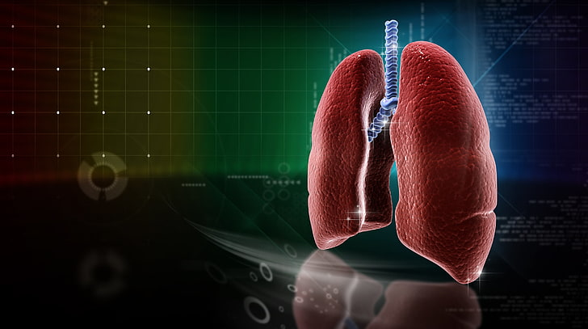
BPD
Bronchopulmonary
Dysplasia

Slide 53
Bronchopulmonary Dysplasia – Studies
6 Meta-analyses¹⁻⁶
No difference in BPD between FO-containing ILEs vs. standard ILE¹⁻⁴
MA specifically evaluating BPD in preterm infants receiving alternative ILE vs. SO ILE⁵
N = 22 RCT or cohort studies (n = 3,781 infants)
No difference in BPD incidence
15 RCTs: n = 1738 infants⁶ ⁻ ¹⁹
Significant decrease in BPD in SMOF ILE vs. OO/SO ILE or SO ILE^{6,7}
No difference in other trials⁸⁻¹⁹
12 Observational/Retrospective studies: n = 4587²⁰ ⁻ ³¹
Significant decrease in BPD in SMOF ILE group vs. non-FO ILE ²²⁻²⁵
No difference^{20,21,26-31}
References on next slide
Notes:
Bottom line: no difference or decrease in BDP with SMOF
MA specifically evaluating BPD in preterm infants: NS trend to ↓ BPD in FO-containing ILE vs. non-FO ILE
Fan et al³⁸: SR and MA regarding BPD in preterm and alternative ILE: N = 22 RCT or Cohort Studies (n = 3781 preterm infants, min GA 23 weeks, min BW 530 gm). 16 RCT, 10 papers evaluated BPD as primary outcome
Incidence of BPD in accordance with the definition that any form of respiratory support or supplementary oxygen was needed at 36 weeks PMA, or that oxygen was needed for at least 28 days.
Alternative ILE vs. SO ILE: Pooled effect generated by the meta-analysis, which did not show statistical significance (OR 0.96, 95% CI 0.80–1.14), NS.
FO ILE vs. non-FO ILE: 18 studies (13 RCT studies and 5 cohort studies) with 2282 patients reported comparison of the use of fish oil-containing ILE and non-fish oil-containing ILE for preterm infants. Fish oil-containing ILE included SMOFlipid, Lipidem, and Omegaven in this review. 15 studies compared SMOF lipids to others and 3 studies compared Omegaven to others. Study of Savini et al. include SMOFlipid group and Lipidem group. The pooled estimate OR was 0.88 (95% CI 0.71 to 1.08), indicating that fish oil-containing ILEs had no protective effect against the occurrence of BPD in preterm infants, compared with non-fish oil-containing ILEs.
(But trend to decreased BPD with FO vs. non-FO, and NO increased risk with FO ILE and BPD)
RCT:
Ozkan et al (2018): RCT, N = 89 infants, n = 47 OO/SO ILE vs. n = 42, SMOF ILE in preterm infants (< 32 wks GA – mean GA 28.1 weeks). Duration of PN: 13.1 days in both groups. Primary outcomes: lipid peroxidation products, total antioxidant capacity (TAC), pro + anti inflammatory cytokines at 0,7,14 days, cholestasis and other comorbidities (BPD, sepsis etc). ILE dose: 1 gm/kg/d day 1 – increased to 3 gm/kg/d. Results: TAC sig higher in SMOF vs. OO/SO at day 7 only. No differences in cytokines. Non-invasive ventilation higher in OO/SO ILE (18.5 days vs. 10.3 days (SMOF), p = 0.01), low rate of PNAC (1 SMOF, 2 OO/SO). BPD NS lower in SMOF vs. OO/SO ILE (14.2% vs. 31.2%, p = 0.2), but severe BPD sig lower in SMOF vs. OO/SO: 7.1% vs. 19.1%, p = 0.02, moderate BPD lower in SMOF, but NS (p = 0.06), no differences in ROP, PDA, IVH, sepsis, EN initiation.
Hsiao et al (2018): DBRCT, SMOF ILE vs. SO/MCT ILE (n = 60 VLBW requiring ventilator support) x 7 days. Primary outcome: IL-1beta and IL-6 levels in serum and BALF. Secondary outcomes: mortality, clinical outcomes (LOS, MV days, O2 days, weight gain, LFT, PNAC, BPD, ROP, NEC, IVH, late-onset sepsis). ILE dose: 1 gm/kg/d on day 1, increased to 3 gm/kg/d days 3 – 7. Results: Sig lower IL-1beta in serum and BALF in SMOF ILE group, IL-6 sig lower in SMOF group. Vent days, O2 days, BPD sig lower in SMOF group (13.3% vs. 36.7%, p = 0.04, OR 0.36, 95%CI 0.21 – 0.86). Multivariate analysis: BPD associated with type of ILE, GA, APGAR at 1 min, ICU days. OR: 0.033, 95%CI = 0.002 – 0.568, p = 0.019. Lower PNAC but NS (6.67% vs. 13.33%, p = 0.35), no differences in other comorbidities.
Repa (2018): DBRCT n = 230, SMOF vs. SO ILE. See slide 38 (CLD incidence: 17% v s. 19%, p = 0.80, days on MV: 6 days in both groups, p = 0.51)
Najm (2017): DBRCT, n = 90, SMOF vs. OO/SO ILE. See slide 31 (BPD incidence: SMOF 58%, OO/SO ILE 42%, p = 0.18)
Skouroliakou 2016: DBRCT, n = 60 VLBW, SMOF vs. SO ILE. Primary outcomes: proinflammatory cytokines (TNFa, IL-6, IL-8), secondary outcomes: alpha-tocopherol, FA profiles. ILE dose – 1 gm/kg/d to 3 gm/kg/d. BPD lower in SMOF group 24% vs. 46%, but NS (p > 0.05 (OR 0.37 (95% CI 0.11 – 1.22)). No differences in any other clinical outcomes (infections, PNC, RDS, growth). Proinflammatory cytokines lower at day 30/EOS (T2) with SMOF vs. SO ILE.
Beken (2014): DBRCT, n = 80 VLBW, SMOF vs. SO ILE. Primary outcome ROP and need for laser photocoagulation. Secondary outcomes: cholestasis, nosocomial infections, NEC, IVH, CLD. Initial ILE dose: 0.5 – 1 gm/kg/d, goal dose 3 gm/kg/d. Sig lower ROP in SMOF vs. SO ILE, no difference CLD (p = 0.74), MV days (p = 0.83) or O2 tx days (p = 0.61) or other clinical outcomes (except higher hypoglycemia in SO ILE group, p = 0.03)
Savini et al (2013): Single center, 5 arm parallel group RCT, 5 ILE (SO ILE, SO/MCT, OO/SO, SMOF, MSF) in preterm infants GA 500 – 1249 gm, (n = 155). Primary outcome: Phytosterol (PS) levels at day 0, 7 and 14 (when infants receiving ~50% PN/~50% EN). Secondary outcomes: growth, clinical outcomes. No differences between groups in BPD (p = 0.8), PDA, NEC, sepsis, cholestasis, growth, LFT. PS were significantly highest in SO ILE group vs. other groups. Campesterol sig lower in SMOF vs. other groups at d14, lowest in SMOF and OO/SO on day 7 vs. other groups, b-sitosterol lower on d7 in SMOF and MSF vs. other groups, lower on day 14 in SMOF vs. SO/MCT and MSF groups.
Huff 2023: See slide 25. No differences in ROP and ROP tx (p = 1.0), BPD (p = 0.877), NICU LOS (NS, p value not reported).
Costa 2021: See slide 39. RCT, n = 101 VLBW, SO ILE vs. SMOF ILE. Primary outcome: HC z-score at 36 weeks PMA. Secondary outcomes: change in wt and lt z scores, late-onset sepsis, PNAC, etc. No difference in ROP, treated ROP, BPD (p = 1.0), PDA, NEC, IVH, PVL, LOS, mortality. ILE intake 3.6, 3.7 gm/kg/d, PN duration: 39.7 days (SMOF), 33.4 days (SO ILE), NS. Higher HC scores with SMOF (p = 0.034) and length (p = 0.017), lower PNAC but NS (8% vs. 20%, p = 0.091).
Yildizdas (2018): RCT, SMOF vs. OO/SO ILE x > = 7 days, n = 67 preterm infants (<32 wks ± <= 1500 gm). Initial ILE dose: 1 gm/kg/d up to 3.5 gm/kg/d (0.25 gm/kg/hr infusion rate). Primary outcome: PNAC. Secondary outcomes: PDA, IVH, NEC, BPD, ROP, nosocomial infections, AO and lipid peroxidation markers, PN and ILE days, growth, LFT, days of ventilation, O2 use, death during NICU stay. Results: Longer time to regain birthweight in OO/SO ILE group (15.5 days vs. 11.4 days, p = 0.006). No differences in PDA, IVH, NEC, BPD (32.3% SMOF vs. 25.8% OO/SO ILE, p = 0.78), ROP. Lower cholestasis in SMOF group: 0 vs. 18.2%, p = 0.011). TBARS higher in OO/SO ILE group at days 0 and 7, but no difference on day 28. SOD level higher in OO/SO ILE on day 28 vs. SMOF (p = 0.014) and decreased significantly in SMOF group (p < 0.001).
Techasatid 2017: 2 center, DBRCT, n = 44 VLBW (< 1250 gm). SMOF ILE vs. SO ILE. Primary outcomes: Cholestasis, biochemical signs of liver dysfunction (ALT, AST, Dbil, GGT, ALP). Secondary outcomes: death, BPD, duration of MV, NEC, ROP, PDA, sepsis, IVH, LOS, growth. ILE: 1.6 gm/kg/d SMOF, 1.7 gm/kg/d SO ILE. BW significantly lower in SMOF group (947 vs. 1060 gm, p = 0.034), GA lower (NS) in SMOF group, PN days 12.5 (SMOF) 10.5 (SO ILE), p = 0.378. BPD: 45.5% vs. 40.9% (SO ILE), p = 0.070, Time on ventilator approached significance (p = 0.05): Higher in SMOF ILE group (20.9 days vs. 8.9 days), no differences in any other outcomes.
D'Ascenzo 2014: RCT, n = 80 preterm infants (500 – 1249 gm), SMOF vs. SO ILE. ILE tested at 2.5 gm/kg/d (STD) or 3.5 gm/kg/d (HIGH). Primary outcome: Plasma DHA on day 7. Secondary outcomes; Plasma FA, TG, free cholesterol, cholesterol esters on days 7 and 14. Plasma bilirubin (AUC of Tbili), clinical outcomes. Results: Plasma DHA sig higher in SMOF vs. SO ILE groups (both doses). Secondary outcomes: Oleic and EPA higher in SMOF and LA and ARA lower in SMOF vs. SO ILE. Plasma TG sig higher in 3.5 gm/kg/d SMOF group. No differences in RDS, PDA, BPD (p = 0.1 (SMOF vs. SO – higher in SMOF vs. SO, but NS, p = 0.4 – between all groups), NEC, cholestasis, late-onset sepsis, mortality, ROP, LFT, IVH, PVL.
Internal data FK: See slide 18. No difference in BPD: 1.2% SMOF, 2.6% SO ILE.

Slide 54
Bronchopulmonary Dysplasia – References
Kapoor V et al. Cochrane Database Syst Rev. 2015;12:CD009172.
Vayalthrikkovil S et al. Am J Perinatol. 2017;34(7):705-715.
Kapoor V. et al. Cochrane Database Syst Rev. 2019;6:CD013163.
Fan X et al. J Perinatology 2020; 40(1): 1585-96.
He T, Huang J, Ren D, Yan S. Brit J Hospital Medicine 2024; 85(10): doi: 10.12968/hmed.2024.0303.
Ozkan H et al. Pediatrics International. 2019;61(4):388-392.
Hsiao CC et al. Clin Nutr. 2019;38(3):1045-1052.
Repa A, Binder C, Thanhaeuser M, et al. J Pediatr. 2018;194:87-93 e81.
Najm S, Lofqvist C, Hellgren G, et al. Clinical nutrition ESPEN. 2017;20:17-23.
Skouroliakou M etl al. Nutr Clin Pract. 2016;31(2):235-244.
Beken S, Dilli D, Fettah ND, Kabatas EU, Zenciroglu A, Okumus N. Early Hum Dev. 2014;90(1):27-31
Savini S et al. Am J Clin Nutr. 2013;98(2):312-318.
Huff KA et al. JPEN 2023; DOI: 10.1002/jpen.2483
Costa S et al. JPEN 2021; 45(1): 94-101.
Yildizdas HY, Poyraz B, Atli G, et al. Pediatr Neonatol. 2019;60(4):359-367.
Techasatid W, et al. Journal of the Medical Association of Thailand. 2017;100:972-979.
D'Ascenzo R, Savini S, Biagetti C, et al. Clinical nutrition (Edinburgh, Scotland). 2014;33(6):1002-1009.
Abrams SA et al. J Nutrition 2024; doi.org/10.1016/j.tjnut.2024.10.005
Yang Q, Kong J, Bai RM et al. Eur J Clin Nutr 2023; 77: 823.
Choudhary N et al. European journal of pediatrics. 2018;177(5):723-731.
Unal S, Demirel N, Erol S, et al. J Matern Fetal Neonatal Med. 2018;31(7):850-856.
Skouroliakou M, Konstantinou D, Agakidis C, et al. 2012;27(6):817-824.
Franco S.et al. J Parenter Enteral Nutr 2021; 45(6): 1204-12.
Tu CF. et al. Pediatr Neonatol. 2020;61(2):224-230.
Asfour SS, Alshaikh B, AlMahmoud L, et al. Nutrients. 2022;14(19).
Li X, Zhao R et al. Asia Pac J Clin Nutr 2023; 32(1): 77 – 84.
Li X, Chen L et al. JPEN 2024; DOI: 10.1002/jpen.2588
28. Li X et al. Indian J of Pediatrics 2025; doi: 10.1007/s12098-024-05394-6
29. Torgalkar R et al. J Perinatol 2019; 39(8): 1118-24.
30. Uberos J, Jimenez-Montilla S, Molina-Oya M, et al. American journal of perinatology. 2021;38(9):952-959.
31. Kim ES, Lee LJ, Romero T, Calkins KL. Journal of Parenteral and Enteral Nutrition. 2023;47(3):354-363.

Slide 55

Sepsis
This Photo by Unknown Author is licensed under CC BY

Slide 56
Sepsis/Late Onset Sepsis
4 Meta-analyses ¹⁻⁴
No difference in any sepsis or culture-proven sepsis
14 RCT: n = 1,715 infants⁵⁻¹⁸
No difference in sepsis incidence
13 observational studies: n = 4893¹⁹⁻³¹
No difference in sepsis incidence ^{19,22,25,28-31}
Increased sepsis (mainly staph epi), p = 0.02²⁰
Clinical sepsis: 3 (SMOF ILE) vs. 1 (SO ILE)
Increased sepsis, p < 0.001²⁴
Decreased sepsis/late-onset sepsis^{21,23,26,27}
References on Next Slide

Slide 57
Sepsis/Late Onset Sepsis – References
Kapoor et al. Cochrane database of systematic reviews 2019; 6: CD013163.
Kapoor et al. Cochrane database of systematic reviews 2019; 6: CD013171.
Vayalthrikkovil S, Bashir RA, Rabi Y, et al. American journal of perinatology. 2017;34(7):705-715.
He T, Huang J, Ren D, Yan S. Brit J Hospital Medicine 2024; 85(10): doi: 10.12968/hmed.2024.0303.
Abdelkareem M, Wahba Y, Shouman B, Mesbah. Indian pediatrics. 2019;56(10):841-844.
Costa S, Cocca C, Barone G, et al. JPEN J Parenter Enteral Nutr. 2021;45(1):94-101.
D'Ascenzo R, Savini S, Biagetti C, et al. Clinical nutrition (Edinburgh, Scotland). 2014;33(6):1002-1009.
Deshpande G, Simmer K, Deshmukh M, Mori TA, Croft KD, Kristensen J. Ped Gastroenterol Nutrition. 2014;58(2):177-182.
Hsiao CC, Lin HC, Chang YJ, et al. Clinical nutrition (Edinburgh, Scotland). 2019;38(3):1045-1052.
Najm S, Lofqvist C, Hellgren G, et al. Clin Nutr ESPEN. 2017;20:17-23.
Savini S, D'Ascenzo R, Biagetti C, et al. The American journal of clinical nutrition. 2013;98(2):312-318.
Tomsits E, Pataki M, Tolgyesi A, Fekete G, Rischak K, Szollar L. Journal of pediatric gastroenterology and nutrition. 2010;51(4):514-521.
Skouroliakou M, Konstantinou D, Agakidis C, et al. Nutr Clin Pract. 2016;31(2):235-244.
Skouroliakou M, Konstantinou D, Koutri K, et al. Eur J Clin Nutr. 2010;64(9):940-947.
Uthaya S, Liu X, Babalis D, et al. Am J Clin Nutr. 2016;103(6):1443-1452.
Repa A, Binder C, Thanhaeuser M, et al. J Pediatr. 2018;194:87-93 e81.
Abrams SA et al. J Nutrition 2024; doi.org/10.1016/j.tjnut.2024.10.005
Yang Q, Kong J, Bai RM et al. Eur J Clin Nutr 2023; 77: 823
Kim ES, Lee LJ, Romero T, Calkins KL. Journal of Parenteral and Enteral Nutrition. 2023;47(3):354-363.
Uberos J, Jimenez-Montilla S, Molina-Oya M, et al. American journal of perinatology. 2021;38(9):952-959.
Choudhary N et al. European Journal of Pediatrics. 2018;177(5):723-731.
Tu CF. et al. Pediatr Neonatol. 2020;61(2):224-230.
Franco S et al. JPEN J Parenter Enteral Nutrition 2021; 45(6): 1204 – 12.
Asfour SS et al. Nutrients 2022; 14(19): doi: 10.3390/nu14193952.
Li X, Chen L et al. JPEN 2024; DOI: 10.1002/jpen.2588
Li X, Zhao R et al. Asia Pac J Clin Nutr 2023; 32(1): 77 – 84.
Khalifa M, Fanag M, Hanafi NF, Gouda H. Senses Sci (Educ Sci Tech) 2024; 11(2): 78 – 88.
Velumula PK, Boddu PK et al. JPEN 2024; doi: 10.1002/jpen.2689.
. Li X et al. Indian J of Pediatrics 2025; doi: 10.1007/s12098-024-05394-6
Yang R, Ding H, Shan J, et al. BMC Pediatr. 2022;22(1):113.
Torgalkar R et al. J Perinatol 2019; 39(8): 1118-24.

Slide 58

NDO
Neurodevelopmental
Outcomes
This Photo by Unknown Author is licensed under CC BY-SA-NC

Slide 59
NDO – DBRCT Secondary Analyses
Two secondary analyses done of Repa et al. 2018
  DBRCT comparing SMOF ILE vs SO ILE and incidence of PNAC in ELBW infants (< 1000 gm)
  N = 230 ELBW infants from 2012 - 2015 at a single level IV NICU (ITT analysis: n = 223 infants)
  Primary outcome: PNAC incidence; secondary outcomes: neonatal comorbidities, growth
Planned secondary analysis to evaluate NDO
Results:
  PNAC incidence in SMOF ILE group 10.1% vs. 16% in SO ILE group ( p = 0.20)
    36% reduction in PNAC (not significant)
  Incidence of PNAC lower than expected in study design
  No difference in neonatal comorbidities including PDA, PAH, NEC, MV, LOS, ROP, death, sepsis, CLD, IVH, growth
ITT – intention to treat
PAH – pulmonary arterial hypertension
Repa et al. J Pediatrics 2018; 194: 87-93.
Notes:
Secondary analyses done of the Repa trial with overview of that original study given here
Very multifactorial
Changes seen over many years (taylor study)
No claims made my company on any NDO
Intention-to-treat analysis is a method for analyzing results in a prospective randomized study where all participants who are randomized are included in the statistical analysis and analyzed according to the group they were originally assigned, regardless of what treatment (if any) they received. This method allows the investigator (or consumer of the medical literature) to draw accurate (unbiased) conclusions regarding the effectiveness of an intervention. This method preserves the benefits of randomization, which cannot be assumed when using other methods of analysis.

Slide 60
NDO – DBRCT Secondary Analyses
Pre-specified secondary analysis of RCT of ELBW¹
  121/223 infants from core study analyzed (n = 63 SMOF ILE, n = 58 SO ILE)
  Secondary analysis of RCT of short-term outcomes (28 weeks PMA)
  Electrophysiologic brain activity: increased continuous background activity SMOF ILE vs. SO ILE (P < .001)
  Maximal brain maturation reached 2 weeks earlier in SMOF ILE vs. SO ILE (P < .001)
Secondary analysis of RCT of ELBW²
  206/223 infants from core study eligible
  Long-term outcomes at 12 months (n = 174) & 24 months corrected age (n = 164)
  No differences; no impact on the type of ILE on NDO (regression analysis) including cognitive, language, and motor scores
Secondary analysis of RCT of ELBW with and without PNAC³
  Long-term NDO at 12 and 24 months
  12 months: n = 21 with PNAC, n = 153 with no PNAC; 24 months: n = 20 with PNAC, n = 144 with no PNAC
  Results: NDO with ELBW who developed PNAC significantly delayed at 12 and 24 months vs. ELBW without PNAC
1. Binder C et al. J Pediatr 2019; 211: 46 – 53.
2. Thanhaeuser M et al. J Pediatr 2020; 226: 142-148.: 10.1016/j.peds.2020.06.056
3. Thanhaueser M et al. Neonatology 2022; 119: 501-9.
Notes:
Binder and Thanhauser were secondary analyses of Repa et al: n – 230 (223 ITT)
Objectives To examine whether a mixed lipid emulsion (SMOF) reduces the incidence of PNAC in (ELBW, <1000 g) infants. Study design: double-blind randomized trial of 230 ELBW infants (June 2012-October 2015) performed at a single level IV neonatal intensive care unit. Patients received either SMOF ILE (intervention) or SO ILE (control) for PN. Primary outcome measure was PNAC (conjugated bilirubin >1.5 mg/dL x 2). The study was powered to detect a reduction of PNAC from 25% to 10%.
Results Reasons for noneligibility of 274 infants screened were refusal to participate (n = 16), death (n = 10), withdrawal of treatment (n = 5), higher order multiples (n = 9), and parents not available for consent (n = 4). ITT analysis was carried out in 223 infants (7 infants excluded after randomization). Parenteral nutrition associated cholestasis was 11 of 110 (10.1%) in the intervention and 18 of 113 (15.9%) in the control group (P= .20). Multivariable analyses showed no statistically significant difference in the intention to treat (adjusted OR 0.428, 95% CI 0.155-1.187; P= .10) or per protocol population (aOR 0.457, 95% CI 0.155-1.347; P= .16). There was no statistically significant effect on any other neonatal morbidity.
Of note, study was powered for an incidence of PNAC of 25% so was underpowered to detect a decrease of 15% (from 25% to 10%). Similar issue with PMR 1 where there was a lower incidence of PNAC than initially calculated for in power analysis.
Costa: Abstract. We hypothesize that the use of an MLE in PN may reduce the loss of head circumference (HC) z-score from birth to 36 weeks’ postmenstrual age (PMA) or at discharge compared with the use of an SLE in VLBW infants. Methods: Infants with BW≤1250 g, without malformations or chromosomal abnormalities, randomly assigned to receive an MLE or an SLE. The primary outcome: change in HC z-score (HC z-score) from birth to 36 weeks’ PMA or at discharge. Secondary outcomes included the change in weight and length z-scores, as well as the incidence of late-onset sepsis and PN-associated cholestasis. Results: Of the 128 infants randomized, 51 infants in the MLE group and 50 infants in the SLE group were analyzed. MLE significantly associated with a decreased loss in HC and length z-scores from birth to 36 weeks’ PMA or at discharge. Conclusions: This is the first randomized controlled trial providing the evidence that anMLE is associated with improved HC growth in comparison with a pure SLE. (JPENJParenter Enteral Nutr. 2020;0:1–8). No differences in secondary outcomes including neonatal comorbidities (ROP, BPD, PVL, IVH, NEC, sepsis, LOS, PNAC etc). PNAC: 8% vs. 19% (SO ILE), p = 0.116
Gallini: Abstract: Background: Few studies in the literature have analyzed the long-term neurodevelopmental outcomes of the administration of a multicomponent versus a soybean-based lipid emulsion (LE) in preterm infants receiving parenteral nutrition (PN). A recent randomized controlled trial conducted in our unit provided evidence of better growth in head circumference during the hospital stay in those who received a multicomponent LE. Methods: This is a 24-month follow-up study of preterm infants, previously enrolled in a randomized trial, who received a multicomponent LE (SMOFlipid®) or a standard soybean-based one (Intralipid®). We evaluated neurodevelopmental outcomes at 24 months of corrected age (CA) in the two groups. Results: Ninety-three children were followed up to the age of 24 months CA. Due to the peculiar time frame of the SARS-CoV-2 pandemic, neurodevelopmental outcomes were evaluated only in 77 children: 37 in the SMOFlipid® group and 40 in the Intralipid® group. No differences in major disability rates or in Griffith’s evaluation were found between the two groups. Conclusions: In our population study, the administration of a multicomponent LE containing fish oil, compared to a soybean-based LE, had no significant effects on neurodevelopmental outcomes in preterm infants at 24 months CA. Beyond the transient enhanced growth of head circumference observed in early life, we failed to find improved neurodevelopmental outcomes at 24 months CA in preterm infants who previously received a multicomponent lipid emulsion containing fish oil (SMOFlipid®) during NICU stay, compared to those who were given pure soybean oil-based emulsion (Intralipid®). In addition, due to the similar auxological outcomes that we reported, we demonstrated the long-term safety of this multicomponent lipid emulsion. Further multicenter randomized controlled trials are needed to confirm our findings, including a larger sample of very preterm infants and focusing on more specific outcomes.
Binder: Objective To assess whether parenteral nutrition for infants of extremely low birth weight using a mixed lipid emulsion that contains fish oil influences electrophysiological brain maturation. Study design The study is a prespecified secondary outcome analysis of a randomized controlled trial of 230 infants of extremely low birth weight receiving a mixed (soybean oil, medium-chain triglycerides, olive oil, and fish oil; intervention) or a soybean oil-based lipid emulsion (control). The study was conducted at a single-level IV neonatal care unit (Medical University Vienna; June 2012 to October 2015). Electrophysiological brain maturation (background activity, sleepwake cycling, and brain maturational scores) was assessed biweekly by amplitudeintegrated electroencephalography (birth to discharge). Results A total of 317 amplitude-integrated electroencephalography measurements (intervention: n = 165; control: n = 152) from 121 (intervention: n = 63; control: n = 58) of 230 infants of the core study were available for analysis. Demographic characteristics were not significantly different. By 28 weeks of postmenstrual age, infants receiving the intervention displayed significantly greater percentages of continuous background activity. Total maturational scores and individual scores for continuity, cycling, and bandwidth were significantly greater. Maximum maturational scores were reached 2 weeks earlier in the intervention group (36.4 weeks, 35.4-37.5) compared with the control group (38.4 weeks, 37.1-42.4) (median, IQR; P < .001). Conclusions Using a mixed parenteral lipid emulsion that contains fish oil, we found that electrophysiological brain maturation was accelerated in infants who were preterm. (J Pediatr 2019;-:1-8). Trial Registration ClinicalTrials.gov: NCT01585935.
Thanhauser et al 2020: Objective To examine whether parenteral nutrition using a mixed lipid emulsion containing fish oil improves the neurodevelopmental outcomes of extremely low birth weight infants. Study design The study is a secondary outcome analysis of a double-blind randomized trial of 230 extremely low birth weight infants performed at a single level IV neonatal care unit (Medical University Vienna; June 2012 - June 2015). Participants received either a mixed lipid emulsion composed of soybean oil, medium chain triglycerides, olive oil, and fish oil, or a soybean oil-based lipid emulsion for parenteral nutrition. Neurodevelopment of study participants was assessed at 12 and 24 months corrected age (August 2013 to October 2017) using the Bayley Scales of Infant-Toddler Development, third edition. Results At discharge, 206 of the 230 study participants were eligible. At 12 and 24 months corrected age, 174 of 206 (85%) and 164 of 206 (80%) infants were evaluated. At 12 months, there was no significant difference in cognitive (mixed lipid: median, 95 [IQR, 85-101]; soybean oil: median, 95 [IQR, 85-100]; P = .71), language (mixed lipid: median, 86 [IQR, 77-94], soybean oil: median, 89 [IQR, 79-94]; P = .48), or motor scores (mixed lipid: median, 88 [IQR, 76-94], soybean oil: median, 88 [IQR, 79-94]; P = .69). At 24 months, there was again no significant difference in cognitive (mixed lipid: median, 95 [IQR, 80-105], soybean oil: median, 95 [IQR, 90-105]; P = .17), language (mixed lipid: median, 89 [IQR, 75-97], soybean oil 89 [IQR, 77-100]; P= .54), andmotor scores (mixed lipid: median, 94 [IQR, 82-103], soybean oil: median, 94 [IQR, 85-103]; P = .53). Conclusions Parenteral nutrition using a mixed lipid emulsion containing fish oil did not improve neurodevelopment of extremely low birth weight infants at 12 and 24 months corrected age. (J Pediatr 2020;-:1-7).

Slide 61
Long-Term NDO with SMOFlipid (> 2 years)
Post-hoc secondary analysis of Repa et al (n = 223), 153/206 infants enrolled in previous secondary analysis (Thanhauser 2020)
Objectives: Impact of SO ILE and SMOF ILE on cognitive and behavioral outcomes of preschool children who were ELBW
Data from Kaufman Assessment Battery for Children II, Child Behavior Checklist 1.5 – 5, anthropometric data collected from medical record at 5.5 years of age
Results:
  No significant differences between groups in cognitive or behavioral outcomes
  No significant differences between groups regarding height, weight, HC
Notes:
This is yet another secondary analysis of the Repa et al study, evaluating long-term NDO at 5.5 years of age. Objective To evaluate the impact of a parenteral lipid emulsion containing fish oil compared with a soybean oil based-lipid emulsion on the cognitive outcome and behavior of preschool children with extremely low birth weight. Study design This was a retrospective secondary outcome analysis of a randomized controlled trial performed between June 2012 and June 2015. Infants with extremely low birth weight received either a mixed (soybean oil, medium chain triglycerides, olive oil, fish oil) or a soybean oil-based lipid emulsion for parenteral nutrition. Data from the Kaufman Assessment Battery for Children II, the Child Behavior Checklist 1.5-5, and anthropometry were collected from medical charts at 5.6 years of age. Results At discharge, 206 of the 230 study participants were eligible. At 5 years 6 months of age, data of 153 of 206 infants (74%) were available for analysis. There were no significant differences in Kaufman Assessment Battery for Children II scores for Sequential/Gsm, Simultaneous/Gv, Learning/Glr, and Mental Processing Index (mixed lipid: median, 97.5 [IQR, 23.5]; soybean oil: median, 96 [IQR, 19.5]; P = .43) or Child Behavior Checklist 1.5-5 scores for internalizing problems, externalizing problems, or total problems (mixed lipid: median, 37 [IQR, 12.3]; soybean oil: median, 37 [IQR, 13.5]; P = .54). Conclusions A Random Forest machine learning regression analysis did not show an effect of type of lipid emulsion on cognitive and behavioral outcome. Parenteral nutrition using a mixed lipid emulsion containing fish oil did not affect neurodevelopment and had no impact on child behavior of infants with extremely low birth weights at preschool age. (J Pediatr 2022;-:1-7).
Child behavior checklist: DSM-5 oriented scale Depressive problems
Anxiety problems Autism spectrum problems
Attention deficit/hyperactivity problems Oppositional defiant problems
Symptom scale Emotionally reactive Anxious/depressed Somatic complaints
Withdrawn Sleep problems
Attention problems Aggressive behavior
Total problems Internalizing problems Externalizing problems Total problems

Slide 62
Neurodevelopmental Outcomes (NDO): SMOF ILE vs. SO ILE
RCT: VLBW ≤ 1250 gm, n = 101 (Costa et al 2021)¹
  Primary outcome: Significantly decreased loss in HC z scores from birth to 36 weeks PMA with SMOF ILE vs. SO ILE
    SMOF ILE: −0.65 ± 0.87 vs. SO ILE −1.07 ± 1.08 , p = 0.034
      HC used as surrogate marker for NDO
    SMOF ILE: significantly decreased loss in length-for-age z scores from birth to 36 weeks PMA, no difference in wt-for age z scores between groups
24-month follow-up trial of RCT (Costa et al 2021, SMOF ILE vs. SO ILE¹), n = 77²
  Primary outcome: Long-term NDO (24-months corrected age (CA))
  Secondary outcomes: Short-term NDO (6 – 12 months CA), auxologic parameters
  Results: No differences in major disability or Griffith’s mental development scale, or auxologic parameters
Costa S et al 2021; JPEN 45(1): 94 – 101.
Gallini et al Nutrients 2023; 15(58): COI 10.3390.nu15010058
VLBW – very low birthweight
Notes:
Gallini and Thanhauser were secondary analyses of Repa et al: n – 230 (223 ITT)
Objectives To examine whether a mixed lipid emulsion (SMOF) reduces the incidence of PNAC in (ELBW, <1000 g) infants. Study design: double-blind randomized trial of 230 ELBW infants (June 2012-October 2015) performed at a single level IV neonatal intensive care unit. Patients received either SMOF ILE (intervention) or SO ILE (control) for PN. Primary outcome measure was PNAC (conjugated bilirubin >1.5 mg/dL x 2). The study was powered to detect a reduction of PNAC from 25% to 10%.
Results Reasons for noneligibility of 274 infants screened were refusal to participate (n = 16), death (n = 10), withdrawal of treatment (n = 5), higher order multiples (n = 9), and parents not available for consent (n = 4). ITT analysis was carried out in 223 infants (7 infants excluded after randomization). Parenteral nutrition associated cholestasis was 11 of 110 (10.1%) in the intervention and 18 of 113 (15.9%) in the control group (P= .20). Multivariable analyses showed no statistically significant difference in the intention to treat (adjusted OR 0.428, 95% CI 0.155-1.187; P= .10) or per protocol population (aOR 0.457, 95% CI 0.155-1.347; P= .16). There was no statistically significant effect on any other neonatal morbidity.
Of note, study was powered for an incidence of PNAC of 25% so was underpowered to detect a decrease of 15% (from 25% to 10%). Similar issue with PMR 1 where there was a lower incidence of PNAC than initially calculated for in power analysis.
Costa: Abstract. We hypothesize that the use of an MLE in PN may reduce the loss of head circumference (HC) z-score from birth to 36 weeks’ postmenstrual age (PMA) or at discharge compared with the use of an SLE in VLBW infants. Methods: Infants with BW≤1250 g, without malformations or chromosomal abnormalities, randomly assigned to receive an MLE or an SLE. The primary outcome: change in HC z-score (HC z-score) from birth to 36 weeks’ PMA or at discharge. Secondary outcomes included the change in weight and length z-scores, as well as the incidence of late-onset sepsis and PN-associated cholestasis. Results: Of the 128 infants randomized, 51 infants in the MLE group and 50 infants in the SLE group were analyzed. MLE significantly associated with a decreased loss in HC and length z-scores from birth to 36 weeks’ PMA or at discharge. Conclusions: This is the first randomized controlled trial providing the evidence that anMLE is associated with improved HC growth in comparison with a pure SLE. (JPENJParenter Enteral Nutr. 2020;0:1–8). No differences in secondary outcomes including neonatal comorbidities (ROP, BPD, PVL, IVH, NEC, sepsis, LOS, PNAC etc). PNAC: 8% vs. 19% (SO ILE), p = 0.116
Gallini: Abstract: Background: Few studies in the literature have analyzed the long-term neurodevelopmental outcomes of the administration of a multicomponent versus a soybean-based lipid emulsion (LE) in preterm infants receiving parenteral nutrition (PN). A recent randomized controlled trial conducted in our unit provided evidence of better growth in head circumference during the hospital stay in those who received a multicomponent LE. Methods: This is a 24-month follow-up study of preterm infants, previously enrolled in a randomized trial, who received a multicomponent LE (SMOFlipid®) or a standard soybean-based one (Intralipid®). We evaluated neurodevelopmental outcomes at 24 months of corrected age (CA) in the two groups. Results: Ninety-three children were followed up to the age of 24 months CA. Due to the peculiar time frame of the SARS-CoV-2 pandemic, neurodevelopmental outcomes were evaluated only in 77 children: 37 in the SMOFlipid® group and 40 in the Intralipid® group. No differences in major disability rates or in Griffith’s evaluation were found between the two groups. Conclusions: In our population study, the administration of a multicomponent LE containing fish oil, compared to a soybean-based LE, had no significant effects on neurodevelopmental outcomes in preterm infants at 24 months CA. Beyond the transient enhanced growth of head circumference observed in early life, we failed to find improved neurodevelopmental outcomes at 24 months CA in preterm infants who previously received a multicomponent lipid emulsion containing fish oil (SMOFlipid®) during NICU stay, compared to those who were given pure soybean oil-based emulsion (Intralipid®). In addition, due to the similar auxological outcomes that we reported, we demonstrated the long-term safety of this multicomponent lipid emulsion. Further multicenter randomized controlled trials are needed to confirm our findings, including a larger sample of very preterm infants and focusing on more specific outcomes.
Binder: Objective To assess whether parenteral nutrition for infants of extremely low birth weight using a mixed lipid emulsion that contains fish oil influences electrophysiological brain maturation. Study design The study is a prespecified secondary outcome analysis of a randomized controlled trial of 230 infants of extremely low birth weight receiving a mixed (soybean oil, medium-chain triglycerides, olive oil, and fish oil; intervention) or a soybean oil-based lipid emulsion (control). The study was conducted at a single-level IV neonatal care unit (Medical University Vienna; June 2012 to October 2015). Electrophysiological brain maturation (background activity, sleepwake cycling, and brain maturational scores) was assessed biweekly by amplitudeintegrated electroencephalography (birth to discharge). Results A total of 317 amplitude-integrated electroencephalography measurements (intervention: n = 165; control: n = 152) from 121 (intervention: n = 63; control: n = 58) of 230 infants of the core study were available for analysis. Demographic characteristics were not significantly different. By 28 weeks of postmenstrual age, infants receiving the intervention displayed significantly greater percentages of continuous background activity. Total maturational scores and individual scores for continuity, cycling, and bandwidth were significantly greater. Maximum maturational scores were reached 2 weeks earlier in the intervention group (36.4 weeks, 35.4-37.5) compared with the control group (38.4 weeks, 37.1-42.4) (median, IQR; P < .001). Conclusions Using a mixed parenteral lipid emulsion that contains fish oil, we found that electrophysiological brain maturation was accelerated in infants who were preterm. (J Pediatr 2019;-:1-8). Trial Registration ClinicalTrials.gov: NCT01585935.
Thanhauser et al 2020: Objective To examine whether parenteral nutrition using a mixed lipid emulsion containing fish oil improves the neurodevelopmental outcomes of extremely low birth weight infants. Study design The study is a secondary outcome analysis of a double-blind randomized trial of 230 extremely low birth weight infants performed at a single level IV neonatal care unit (Medical University Vienna; June 2012 - June 2015). Participants received either a mixed lipid emulsion composed of soybean oil, medium chain triglycerides, olive oil, and fish oil, or a soybean oil-based lipid emulsion for parenteral nutrition. Neurodevelopment of study participants was assessed at 12 and 24 months corrected age (August 2013 to October 2017) using the Bayley Scales of Infant-Toddler Development, third edition. Results At discharge, 206 of the 230 study participants were eligible. At 12 and 24 months corrected age, 174 of 206 (85%) and 164 of 206 (80%) infants were evaluated. At 12 months, there was no significant difference in cognitive (mixed lipid: median, 95 [IQR, 85-101]; soybean oil: median, 95 [IQR, 85-100]; P = .71), language (mixed lipid: median, 86 [IQR, 77-94], soybean oil: median, 89 [IQR, 79-94]; P = .48), or motor scores (mixed lipid: median, 88 [IQR, 76-94], soybean oil: median, 88 [IQR, 79-94]; P = .69). At 24 months, there was again no significant difference in cognitive (mixed lipid: median, 95 [IQR, 80-105], soybean oil: median, 95 [IQR, 90-105]; P = .17), language (mixed lipid: median, 89 [IQR, 75-97], soybean oil 89 [IQR, 77-100]; P= .54), andmotor scores (mixed lipid: median, 94 [IQR, 82-103], soybean oil: median, 94 [IQR, 85-103]; P = .53). Conclusions Parenteral nutrition using a mixed lipid emulsion containing fish oil did not improve neurodevelopment of extremely low birth weight infants at 12 and 24 months corrected age. (J Pediatr 2020;-:1-7).

Slide 63
Neurodevelopmental Outcomes (NDO): SMOF ILE vs. SO ILE
Pre-Post Cohort study, ELBW (< 29 wks GA, mean GA 26 wks), n=554¹
  Primary outcomes: Composite mortality or significant NDI and composite of mortality and any NDI at 18 – 24 months corrected GA
  Secondary outcomes: Significant NDI, any NDI, BSID-III cognitive scores, mod-severe hearing impairment, visual impairment
  Primary outcome: No difference in death or significant NDI (SMOF ILE vs. SO ILE)
  Significantly decreased adjusted and non-adjusted odds of any death & any NDI, any NDI, and significantly decreased odds of adjusted Bayley III language scores < 85 and < 70 in SMOF ILE at 18 and 24 months
Torgalkar R et al. Journal of Perinatology 2020; 41(11): 1712 – 18
NDI – neurodevelopmental impairment

Slide 64
Summary and Conclusions
100% FO ILE has been approved since 2018 for neonatal use in patients with PNAC
SMOF ILE (15% FO) has been approved for neonatal use since 2022
Both 100% FO and SMOF ILEs have RCTs supporting safety and appropriate growth as compared to other ILEs
Fatty acid patterns reflect the ILE composition
  EFAD not seen with SMOF ILE or 100% FO ILE when dosed appropriately
ASPEN guidelines for parenteral nutrition in the NICU recommend SO ILE or Multicomponent-oil ILE with daily advancement of ILE to goal dose 3/g/kg/d independent of ILE type (Omegaven is not included given its indication and dosing)

Slide 65


Connect on LinkedIn
Elisabeth Biggs, MS, PA-C, RD, CNSC
Elisabeth.Biggs@Fresenius-Kabi.com
Medical Science Liaison, Medical Affairs
Parenteral Nutrition, Fresenius Kabi USA

